Slide 1

World record Soaring trough the clouds LIve demo of 15 clouds
The Oracle ACE Soaring Clouds Team
Oracle PaaS Partner Community Forum
29th March 2017, Split, Croatia

Slide 2
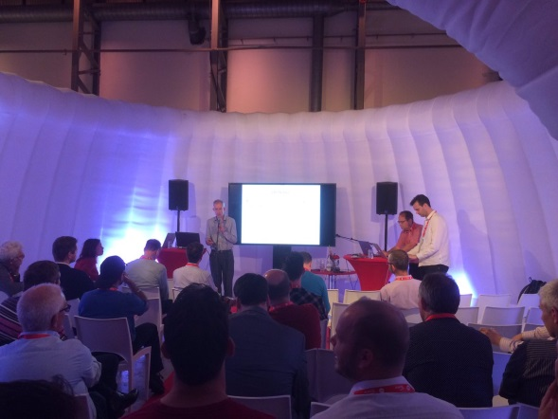
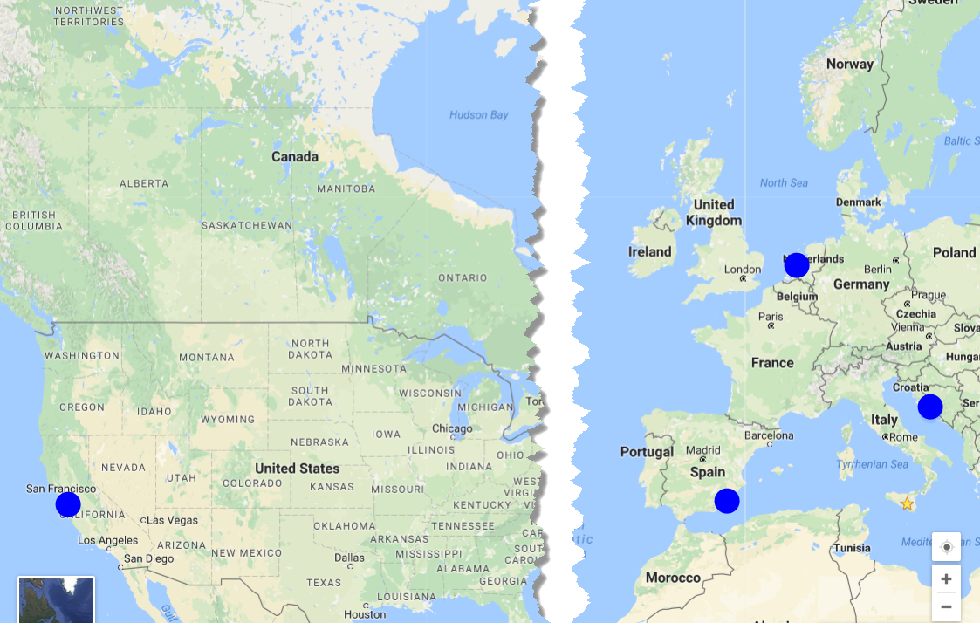
Soaring through the clouds
Prepared by international team of Oracle ACE Directors
Presented three times before today:
Valencia, March 2016
Katwijk, June 2016
San Francisco, September 2016
Objective: demonstrate live a working end-to-end integrated flow using Oracle PaaS Cloud Services
and provide insight in how it is created and what the main challenges were

Slide 3


end-to-end integrated flow using AS MANY Oracle PaaS Cloud Services as possible

Slide 4
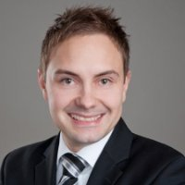
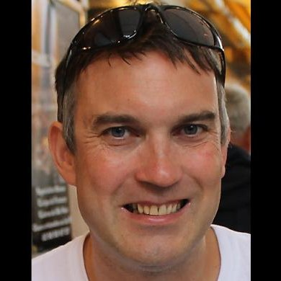

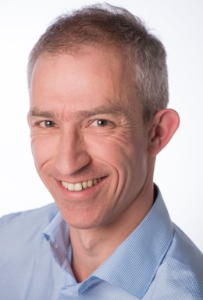
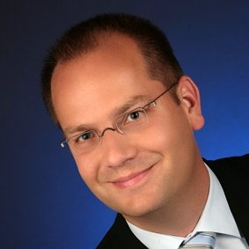


The Team
Distributed
Three countries, Five partners, Five Locations
The Cloud is omnipresent
except when there is a form of outage

Slide 5
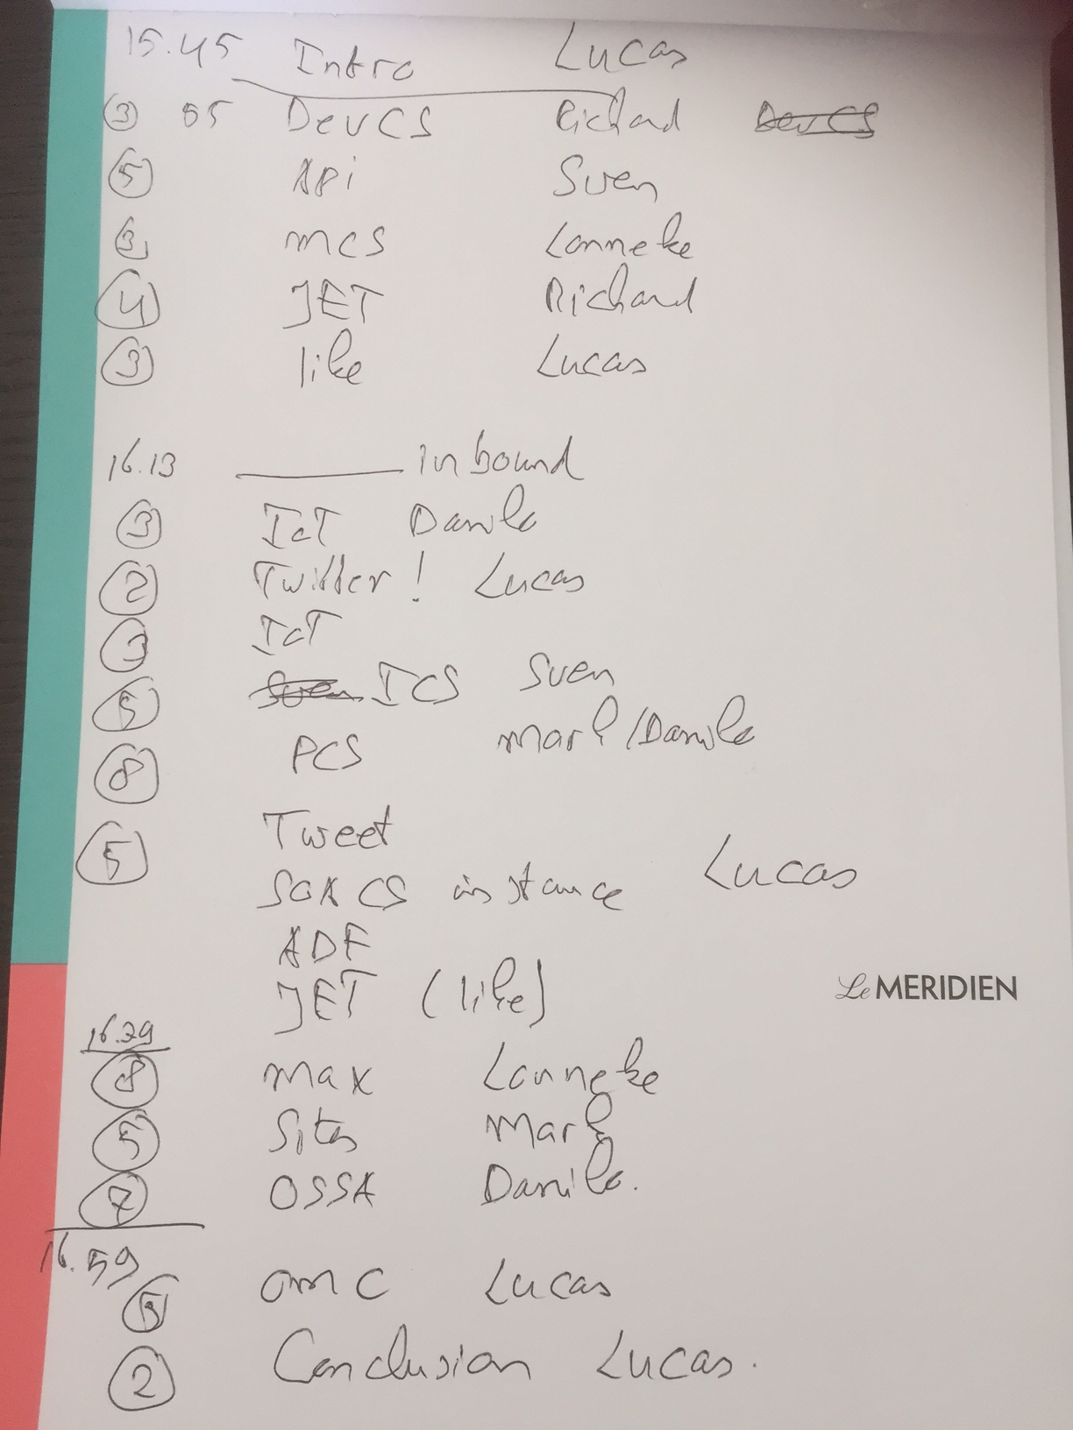
The plan

Slide 6





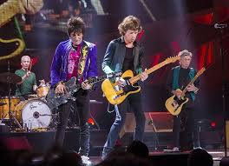

Business scenario (2016)
Analyze Twitter traffic
& Voting Machines
Evaluate Proposal
Publish Enriched Approved Proposals on Web Portal
Oracle OpenWorld 2017

Slide 7
Extended business scenario (2017)
Provide end to end monitoring at business and IT level
Analyze Twitter traffic
& Voting Machines
Evaluate Proposal
Lower cost/increase speed of using 3rd party APIs
Send email,
Update Document, …
Publish Enriched Approved Proposals on Web Portal
Access Artist proposal through Chat client
Publish Business APIs
Publish through Mobile App
Oracle OpenWorld 2017
Use automated collaboration platform with source control and continuous delivery

Slide 8



Cloud services architecture
Real “Things” (Pis, Arduino’s, …)
Audience
IoT CS
ACCS
DBaaS
ICS
SOA CS
Sites CS
PCS
JCS
MCS
Doc CS
Conversations
JET on
AppContainer CS

Slide 9






Cloud services architecture
Real “Things” (Pis, Arduino’s, …)
Application Cache
Audience
(O)SSI
IoT CS
ACCS
DBaaS
LA
LA
ICS
Event Hub
SOA CS
Sites CS
PCS
APM
OMC
(APM, LA)
JCS
LA
APM
LA
API P
MCS
Doc CS
Conversations
ChatBot
JET on
AppContainer CS
Dev CS
MAX
APM

Slide 10


Integrating cloud services – vertically and horizontally
ACCS
ICS
Compute
DBaaS
JCS
SOA CS
Storage
IoTCS
Compute
DBaaS
JCS
Storage
Compute
DBaaS
Storage
Compute
Compute
Storage
Storage

Slide 11
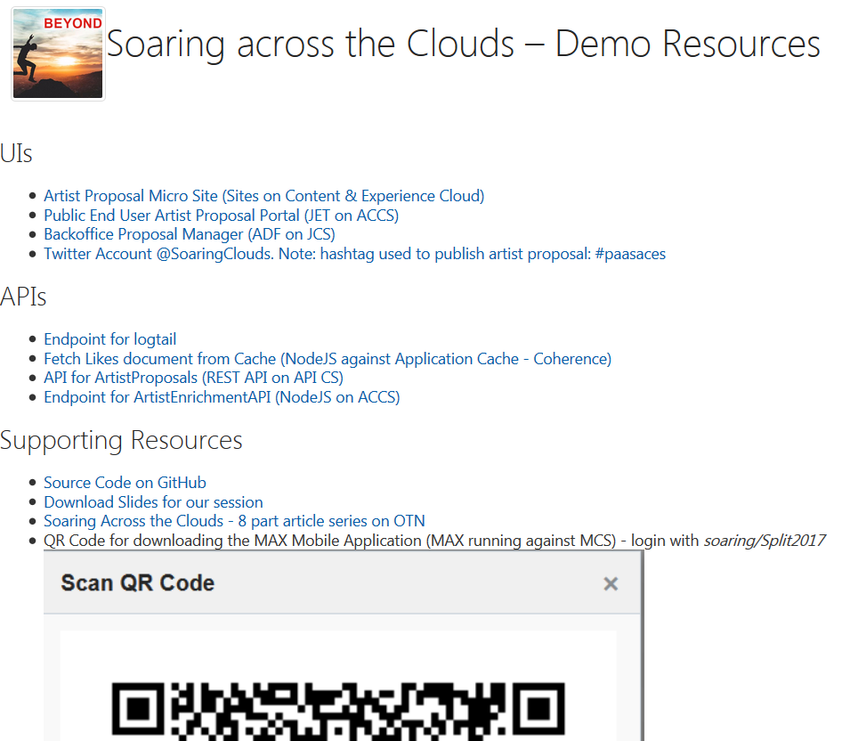
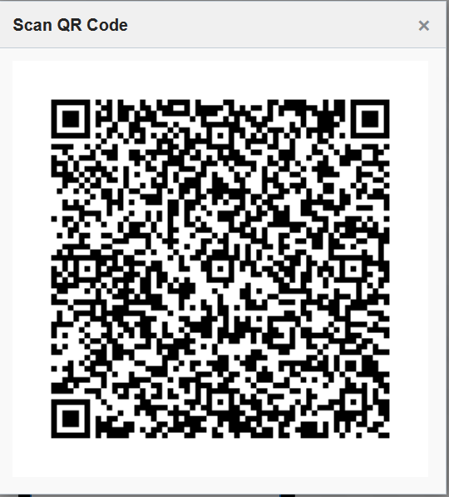
Live Endpoints & Resources
http://tinyurl.com/SoaringSplit

Slide 12
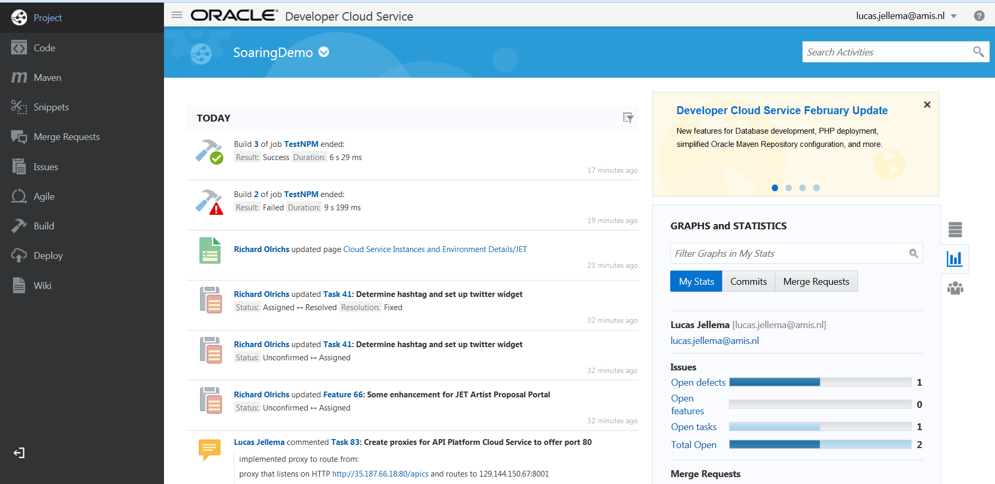
First Steps…
Dev CS

Slide 13
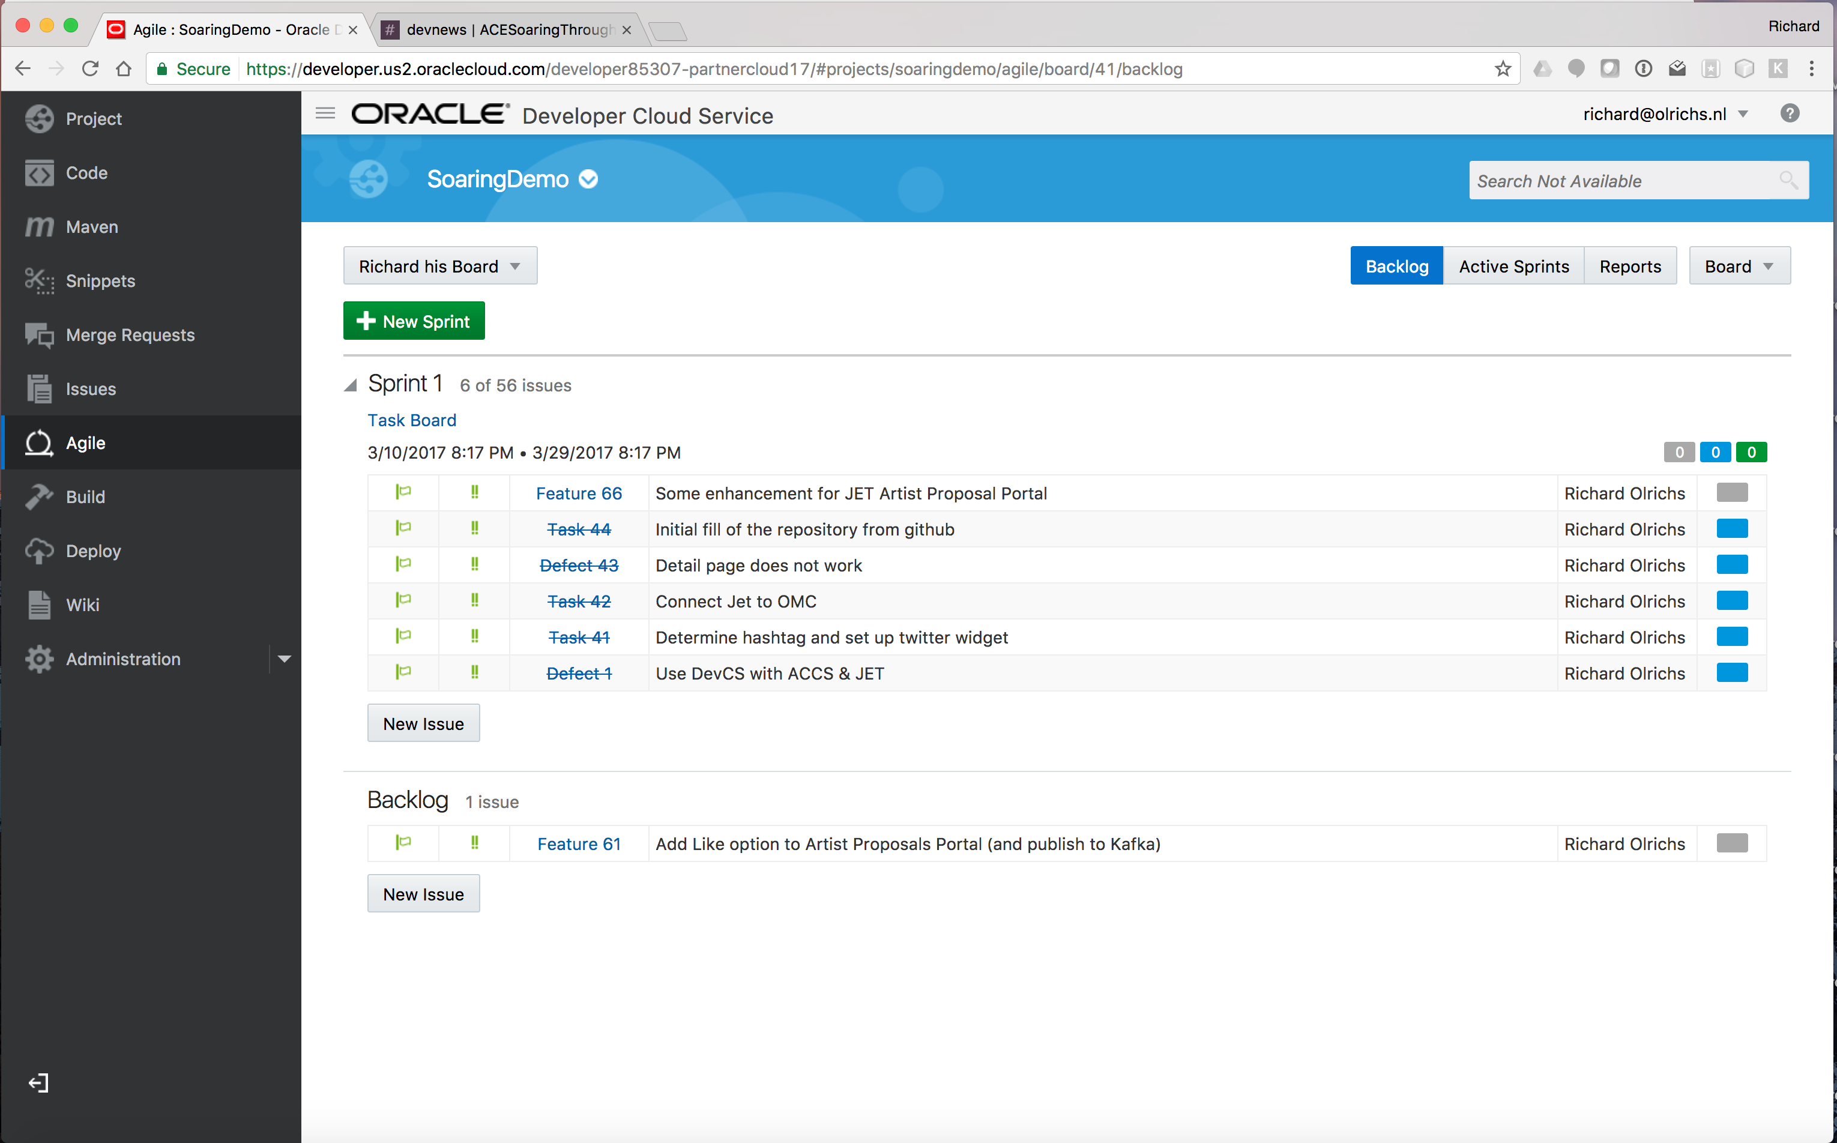
Dev CS

Slide 14
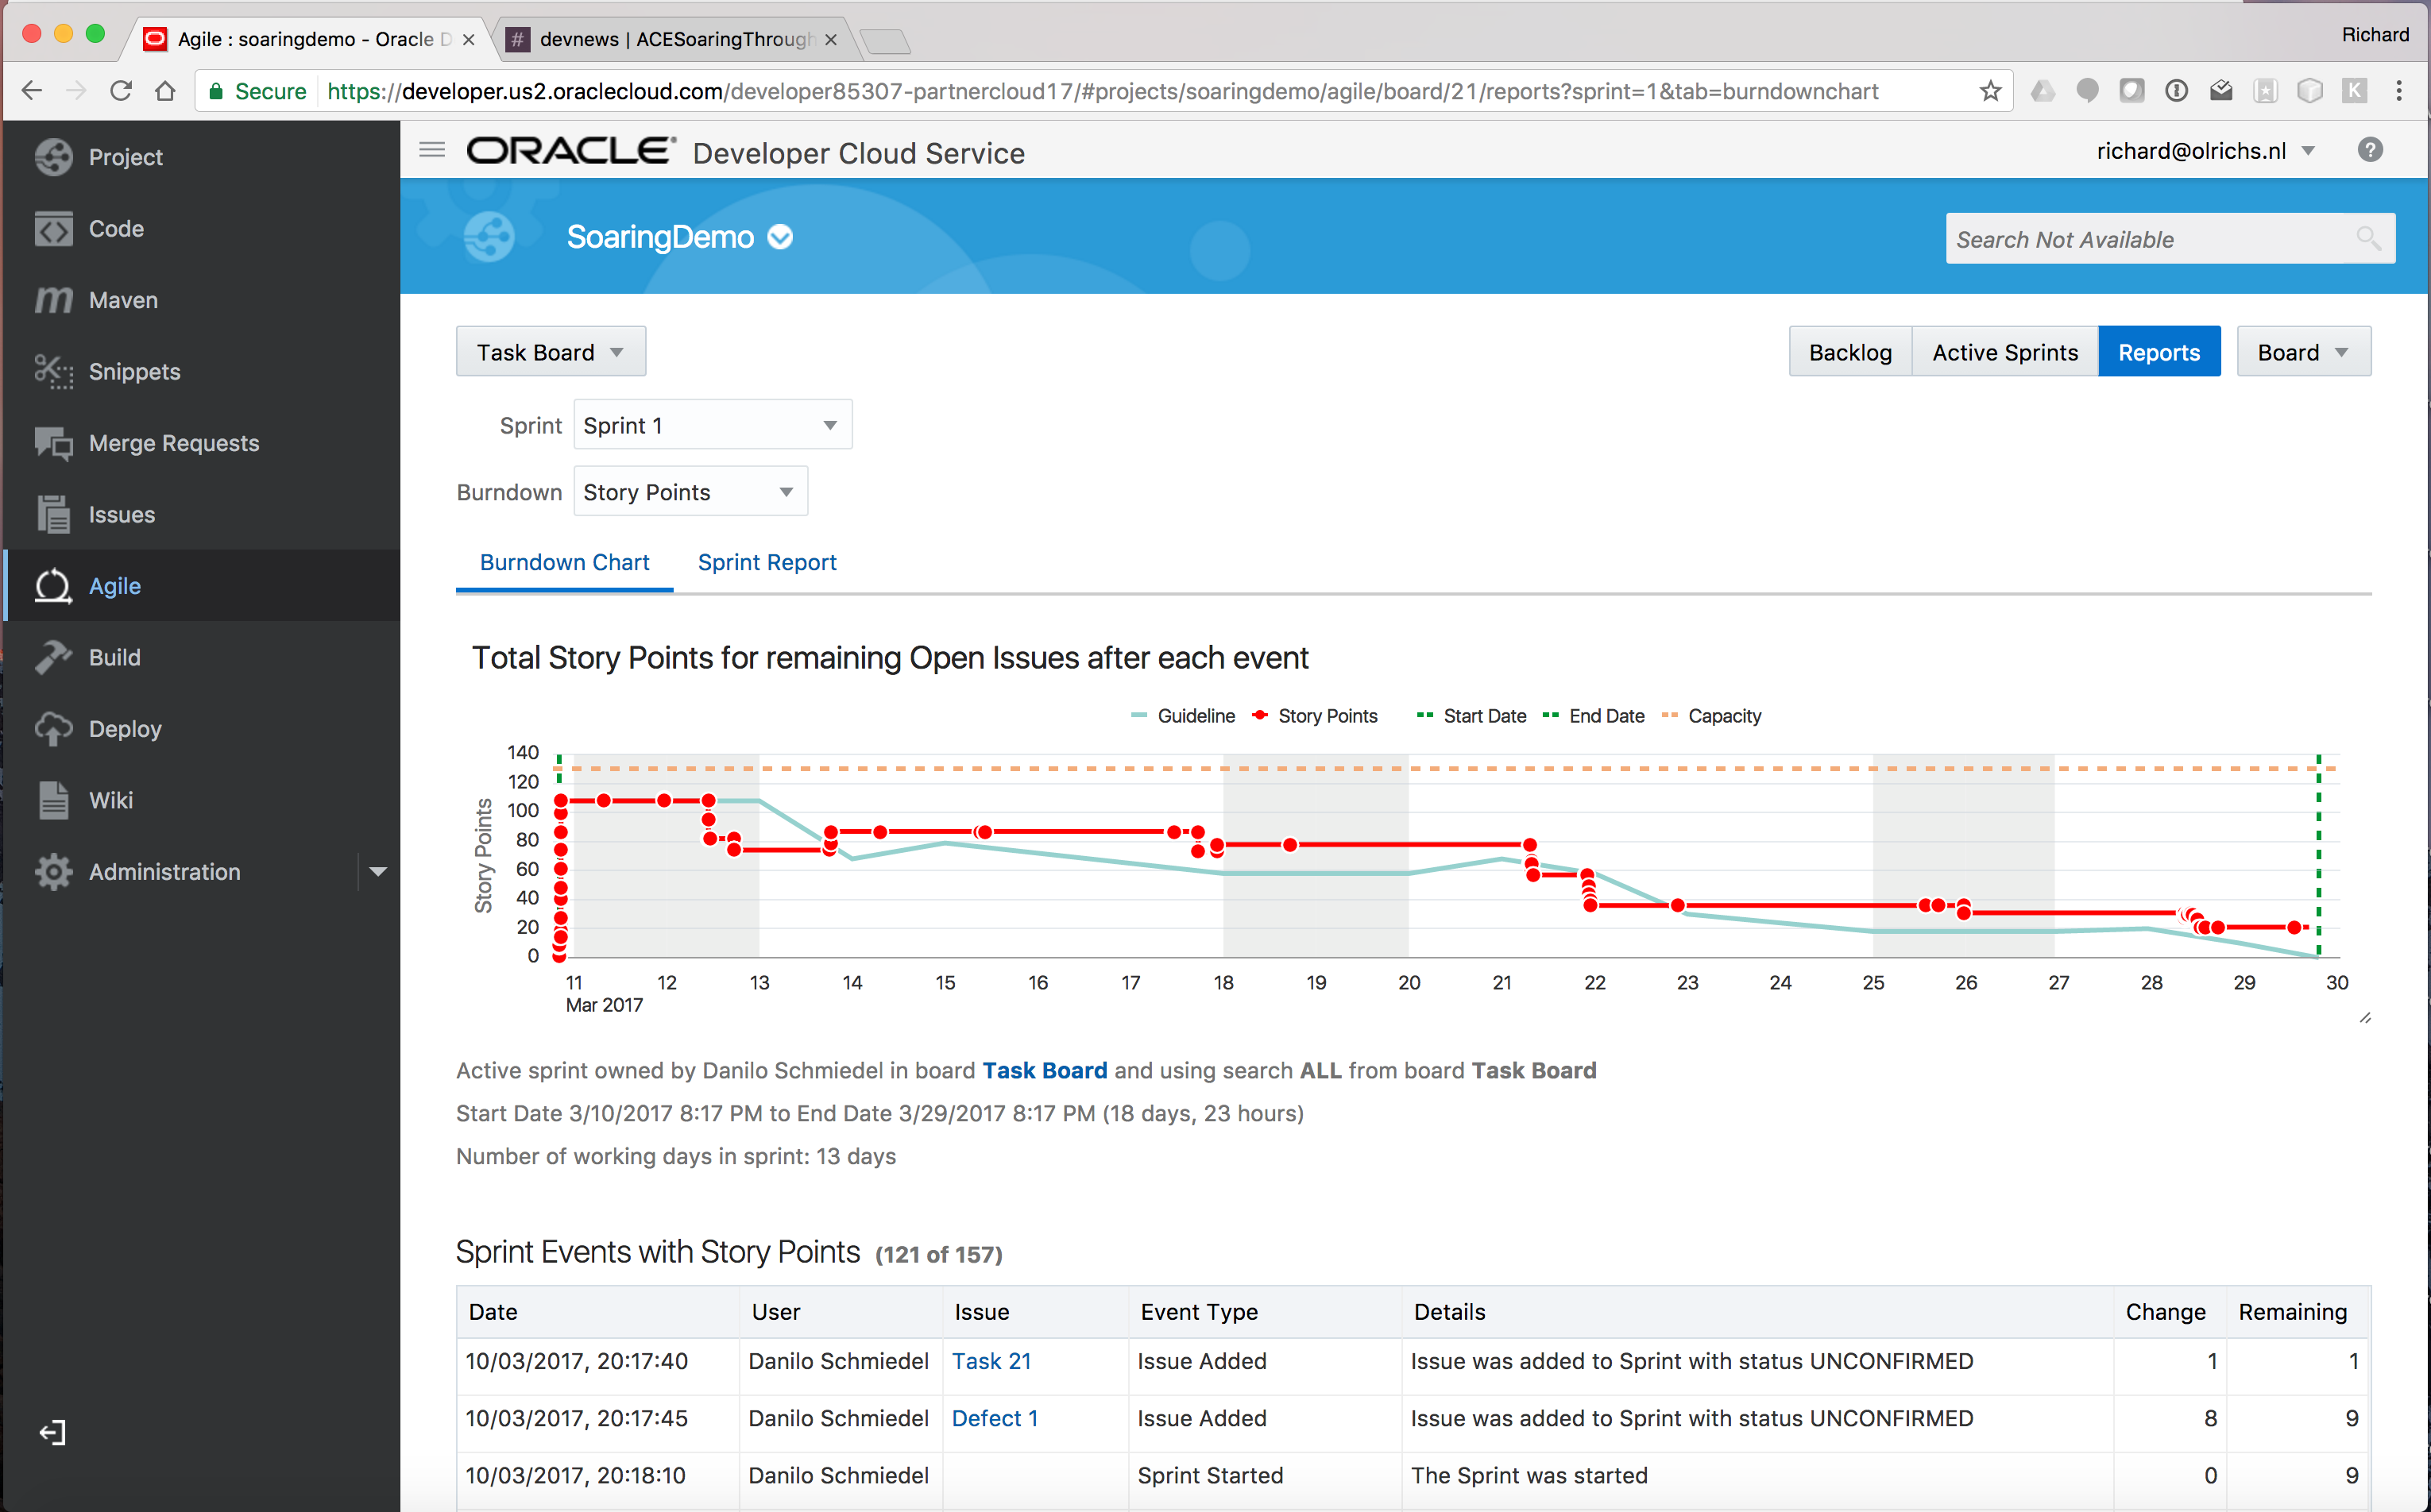

Slide 15
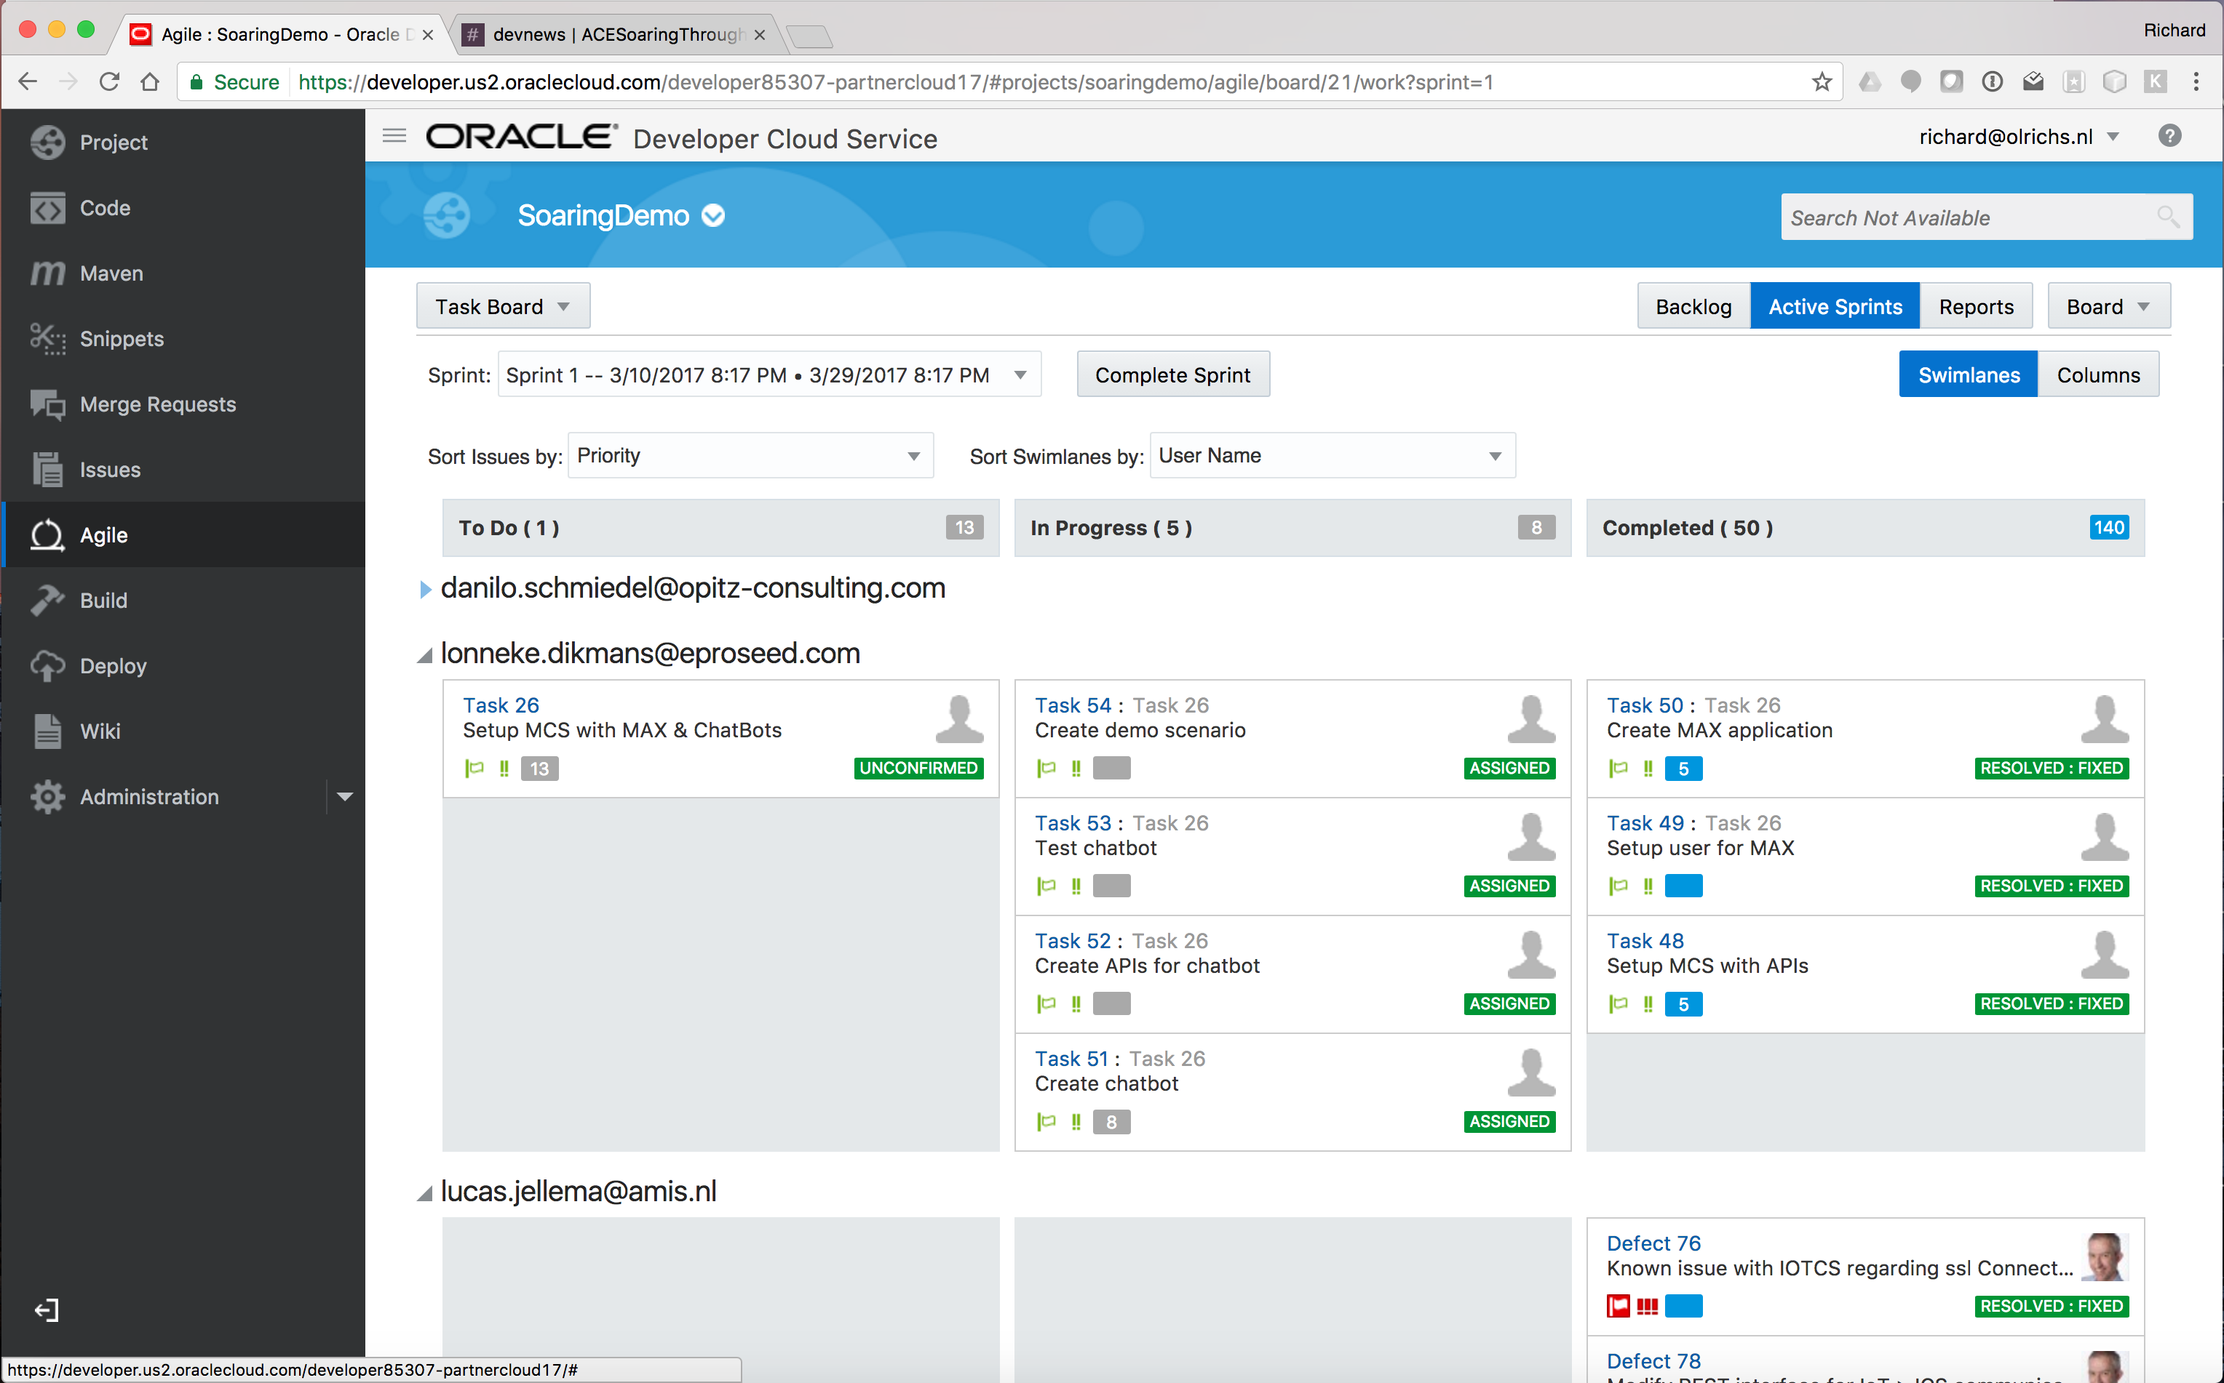

Slide 16
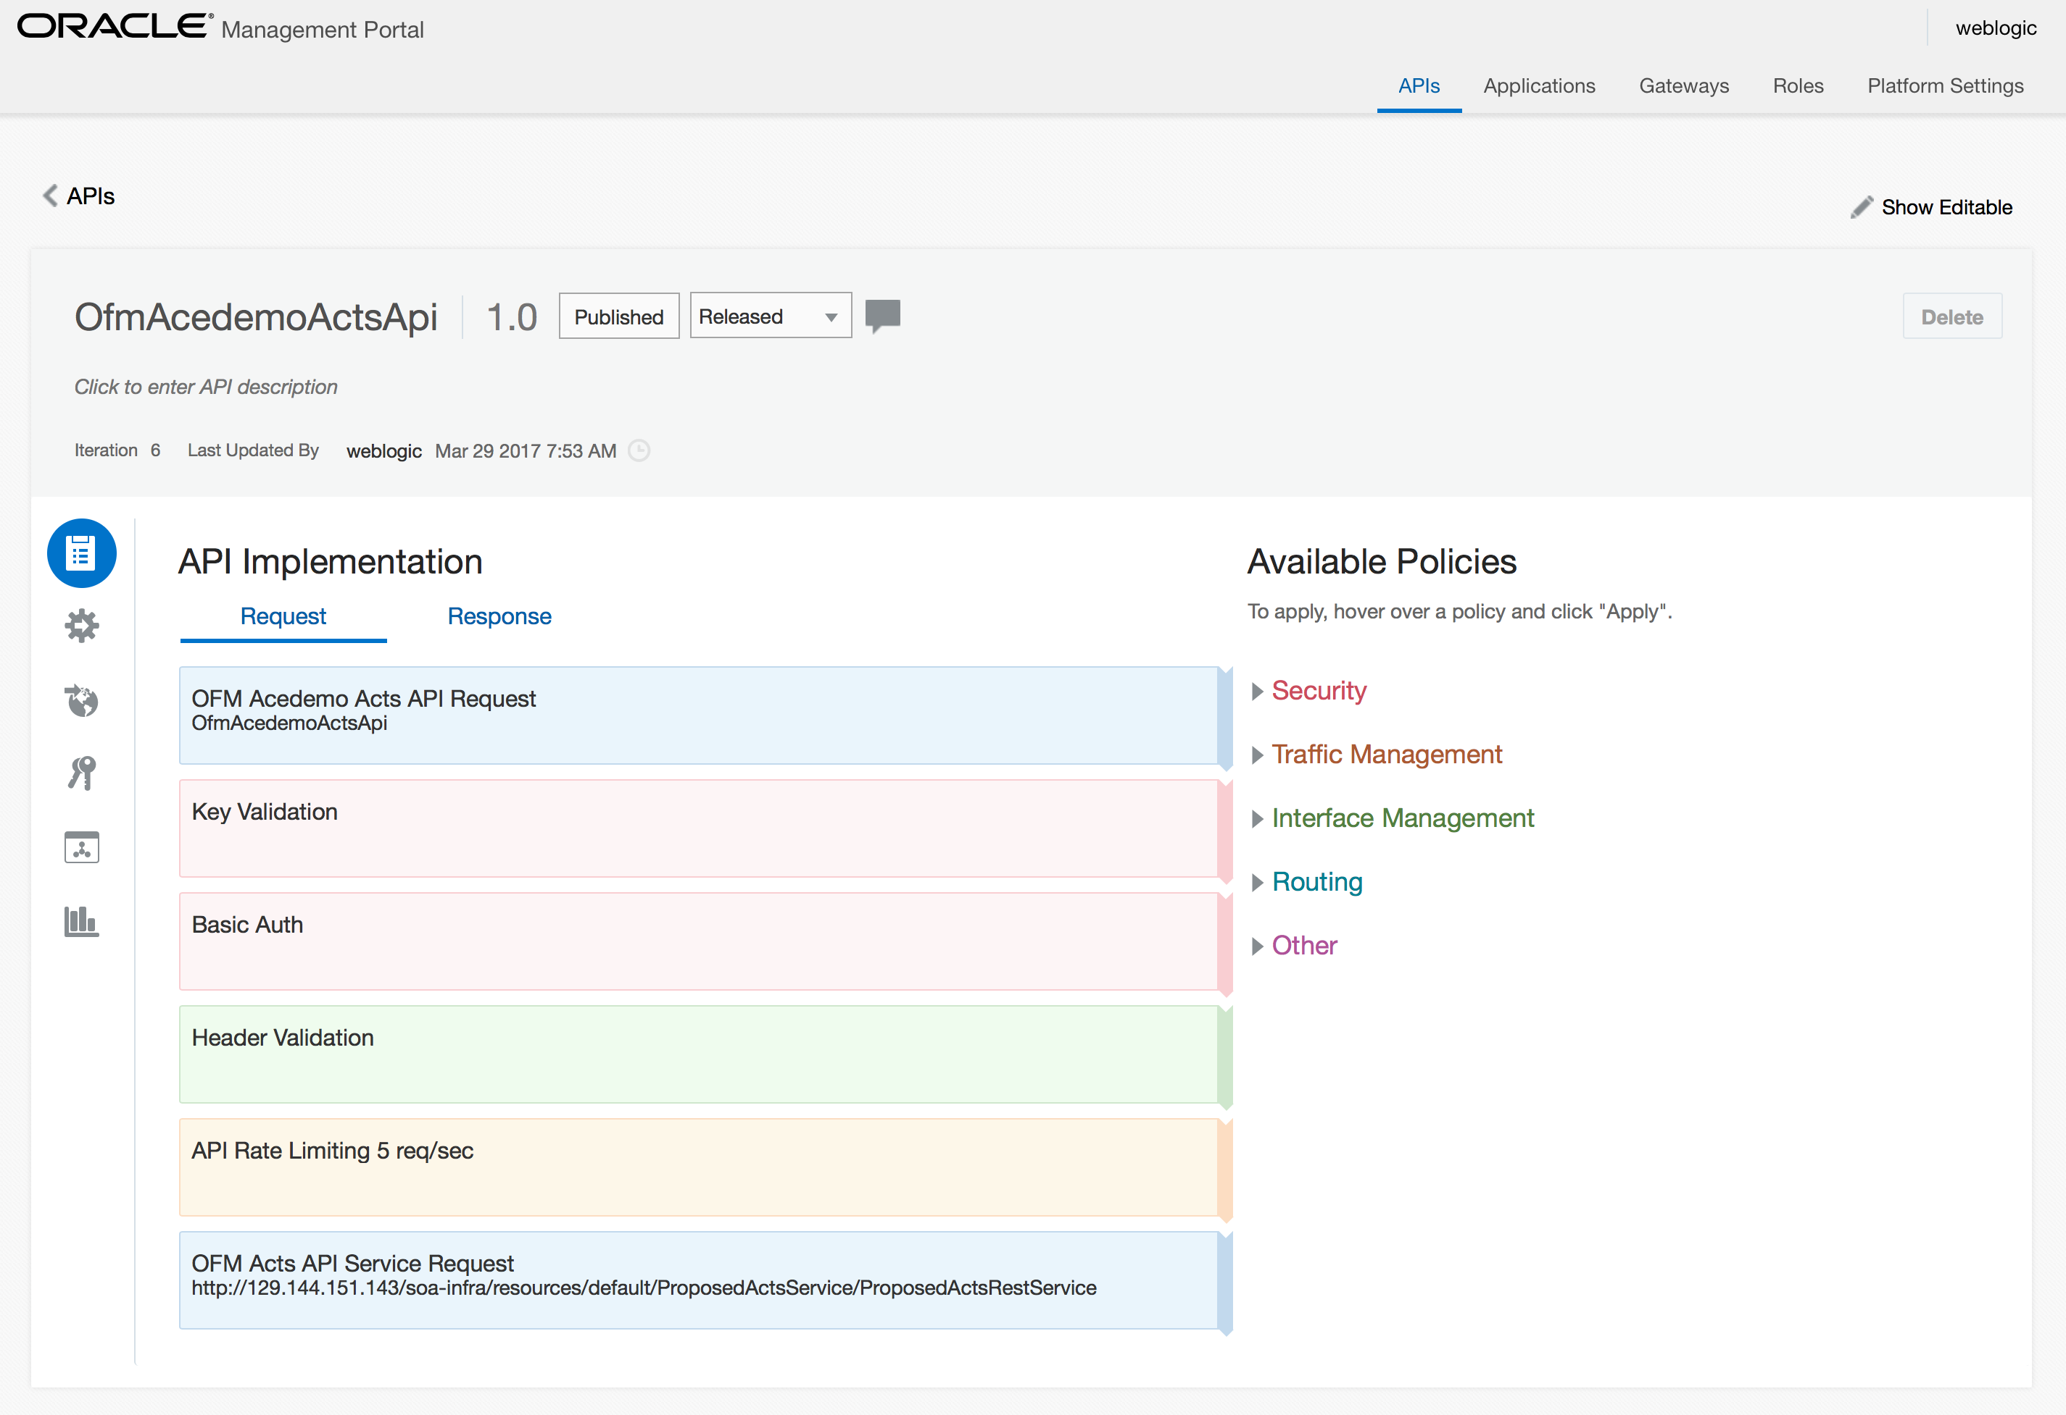
API CS

Slide 17
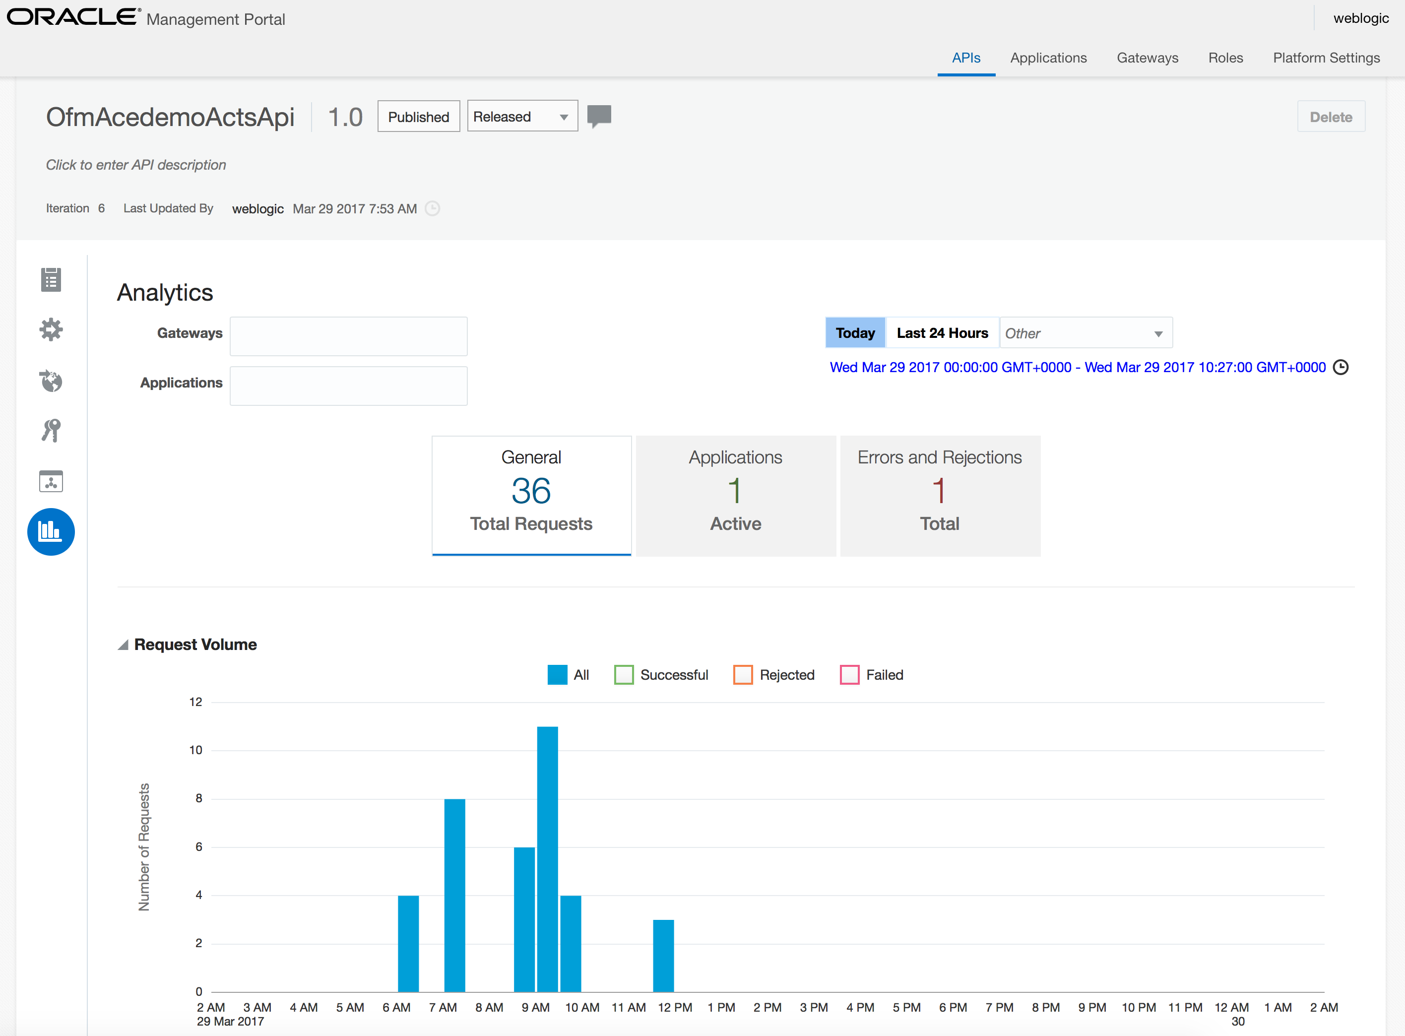
API CS

Slide 18
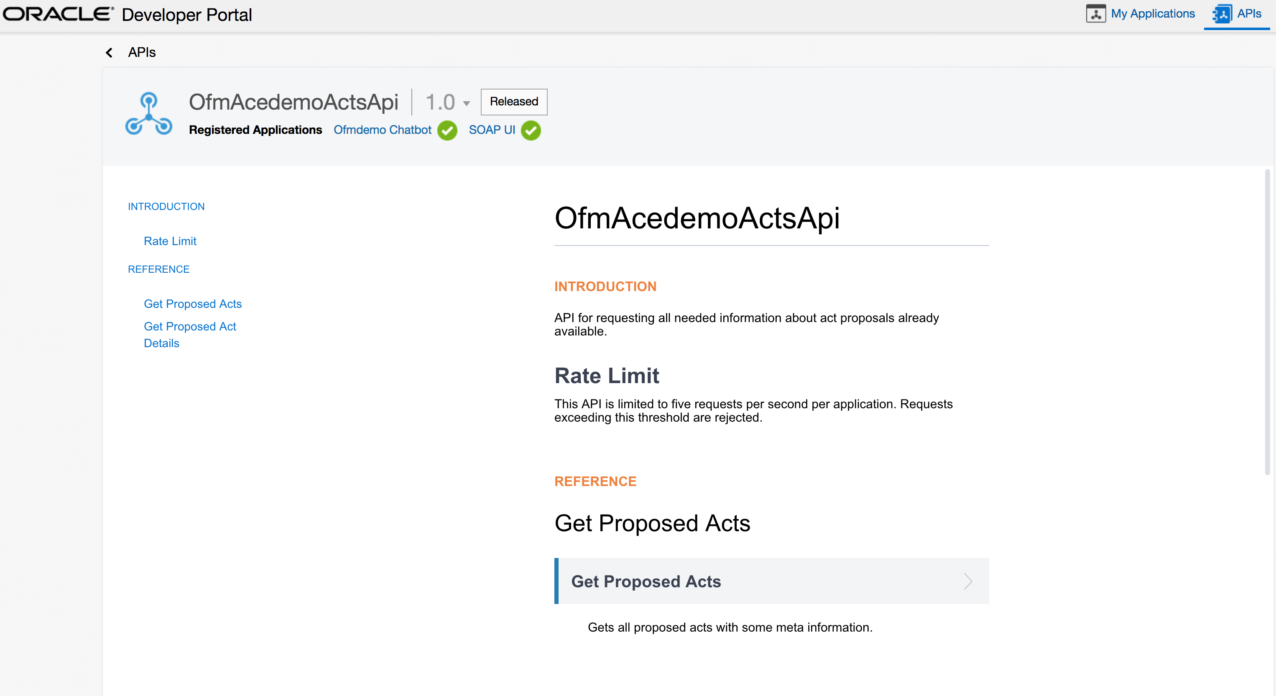
API CS

Slide 19
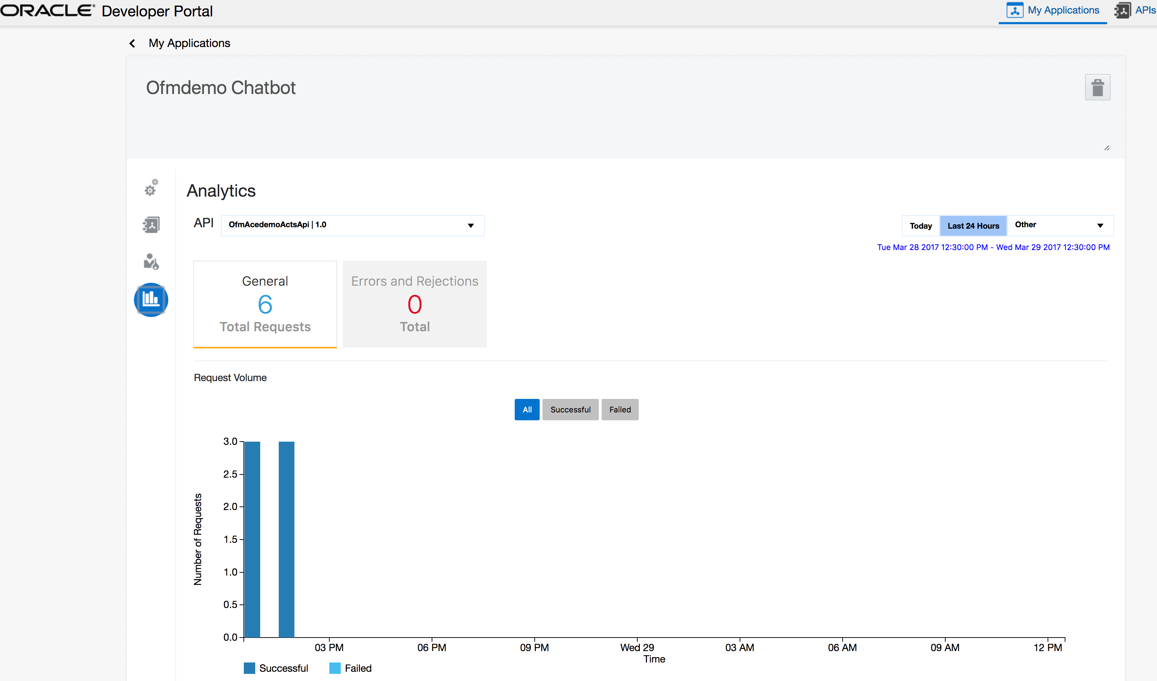
API CS

Slide 20
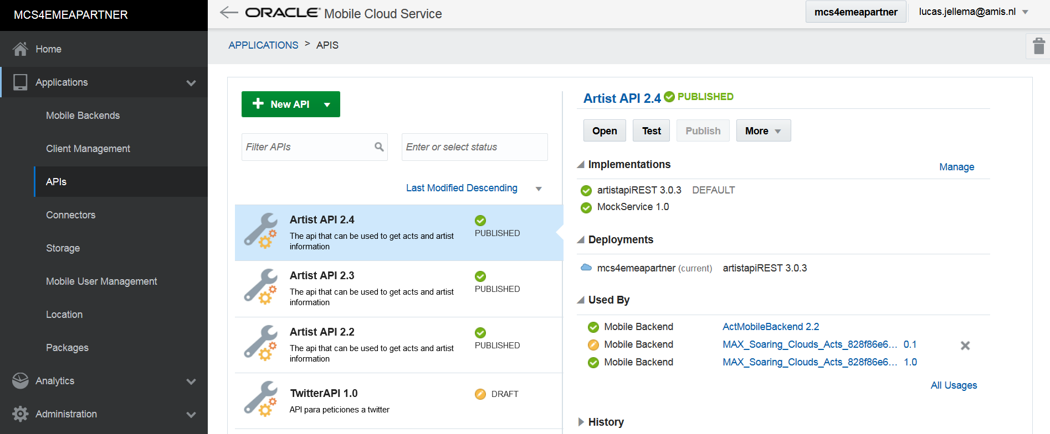
MCS

Slide 21
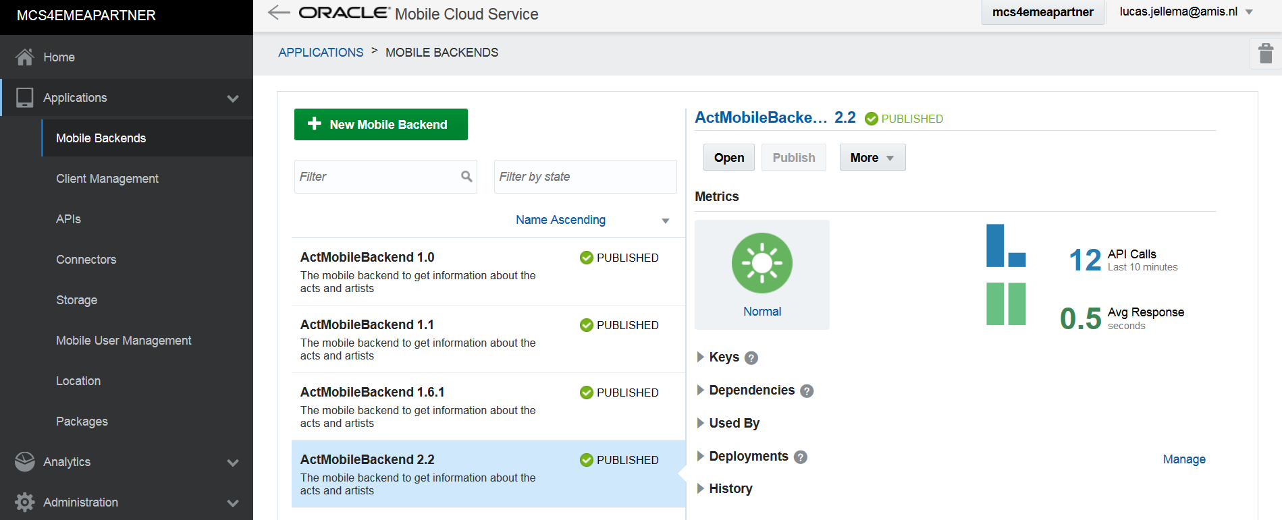
MCS

Slide 22
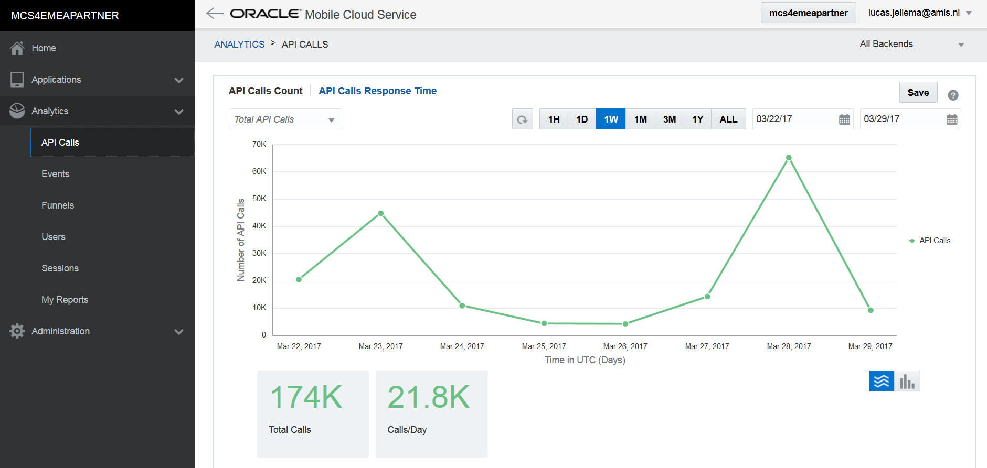
MCS

Slide 23
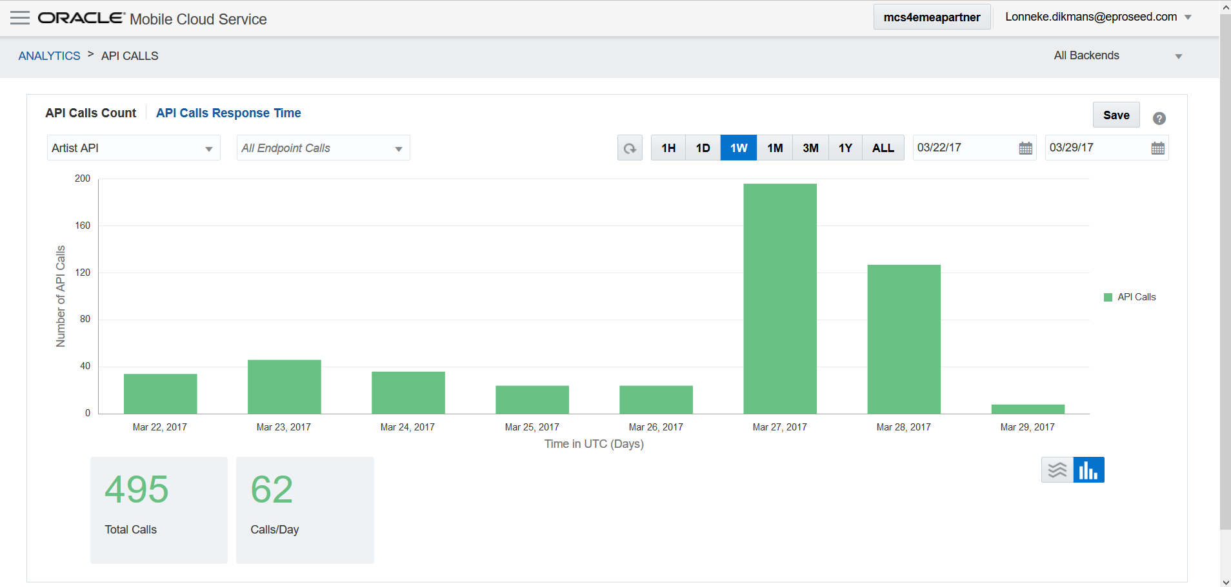
MCS

Slide 24
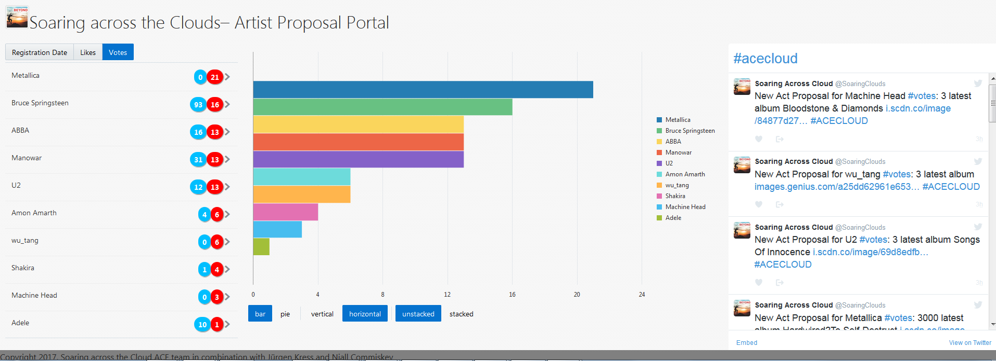
The end user portal – JET on ACCS

Slide 25
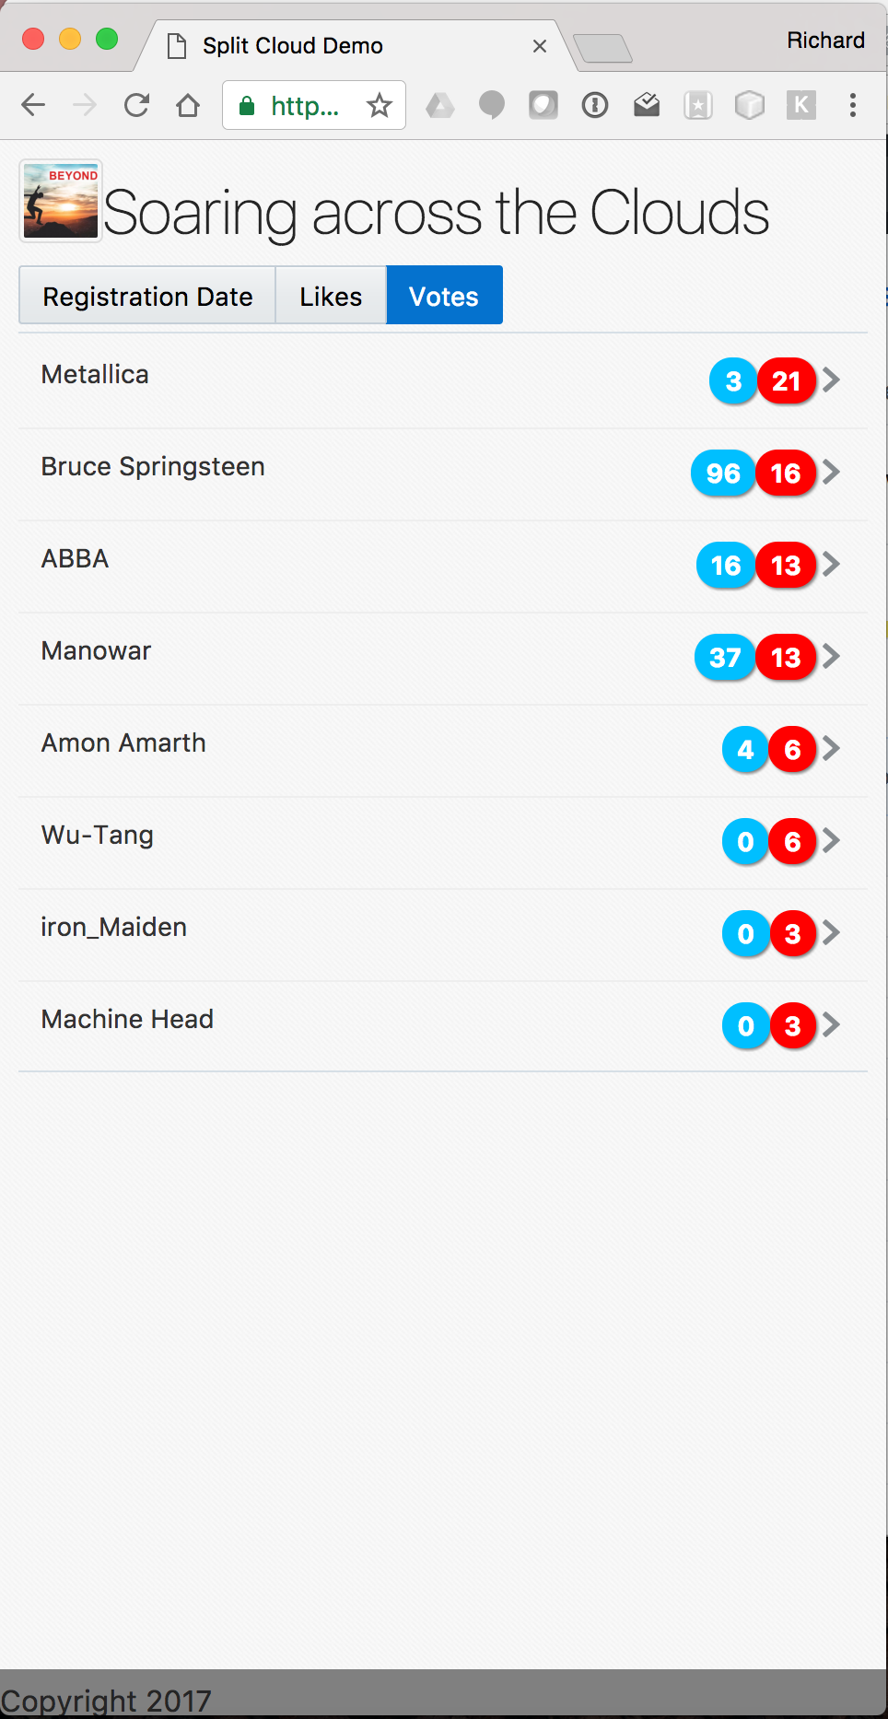
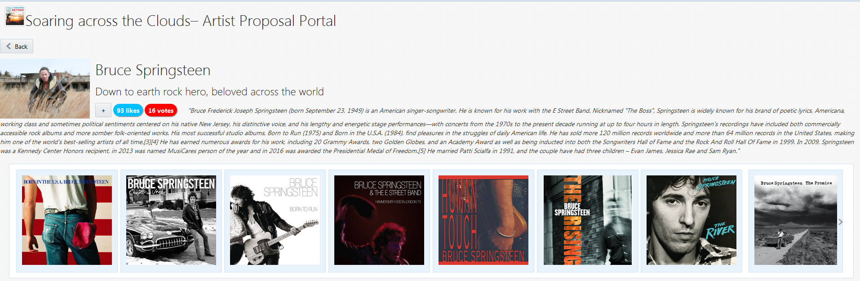

Slide 26
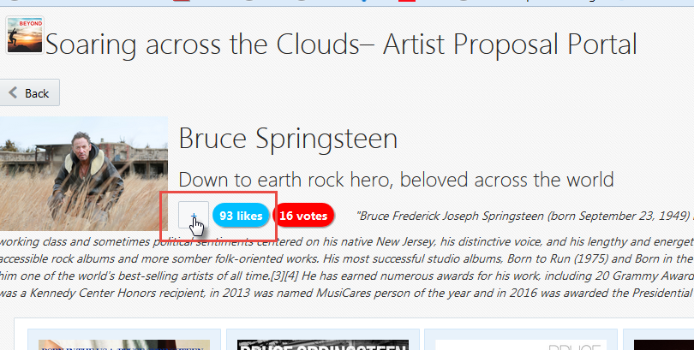
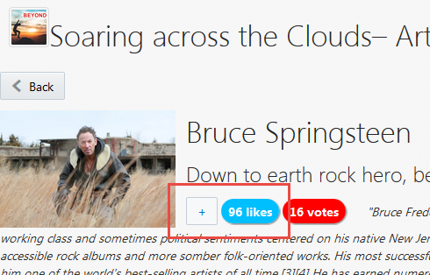
Liking an artist in the portal

Slide 27





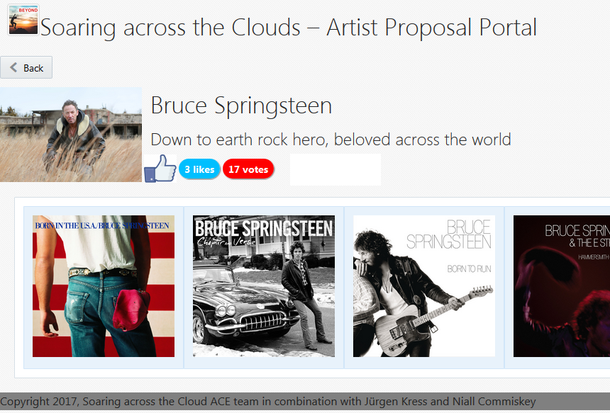



Likes
Application Cache
ACCS
API P
Event Hub
MCS
MAX APP

Slide 28
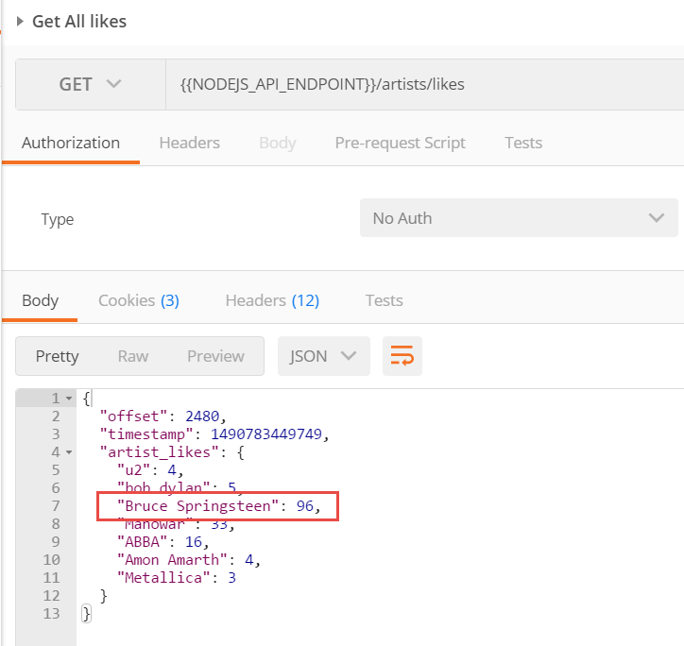

Slide 29
The audience participation story
Real “Things” (Pis, Arduino’s, …)
Audience
IoT CS
ICS

Slide 30
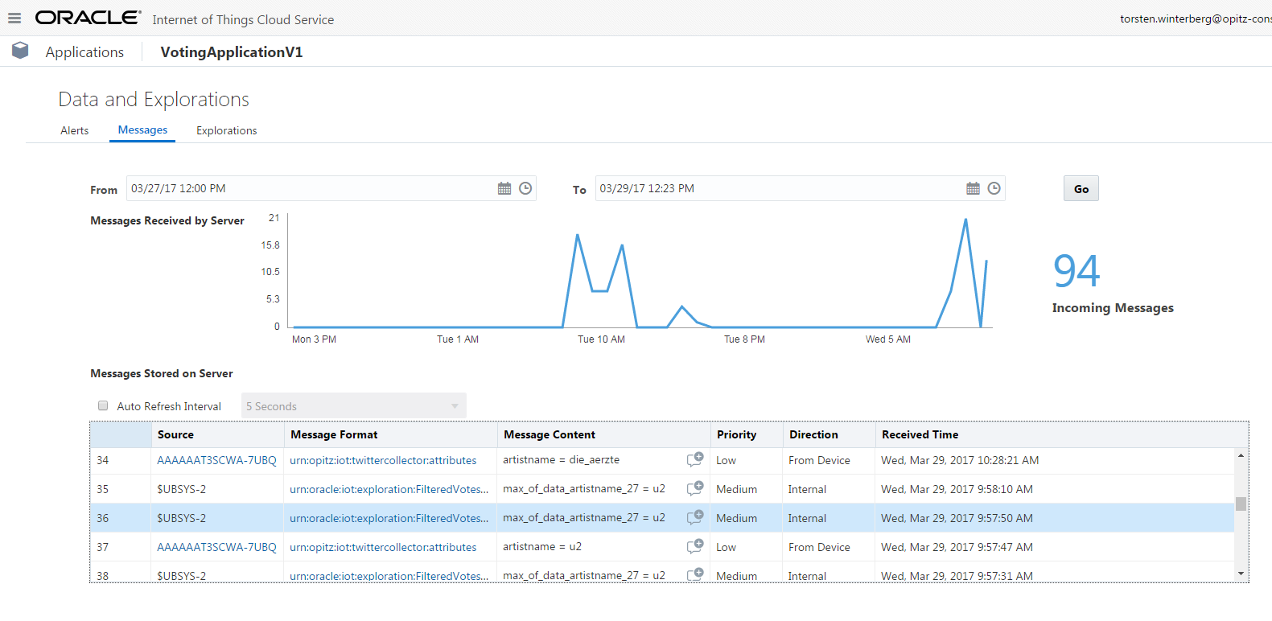
Incoming Stream Exploration
IoT CS

Slide 31
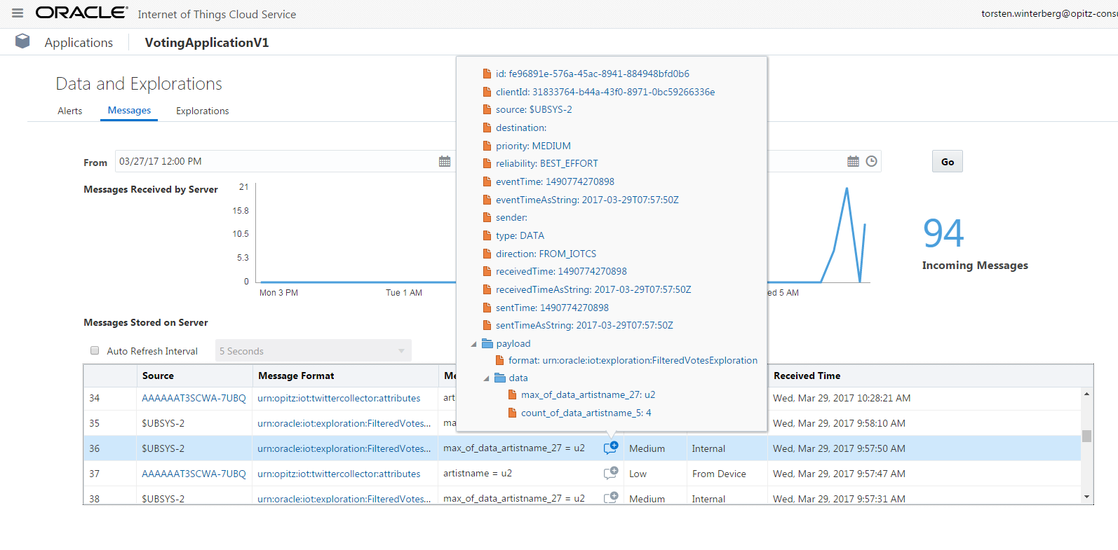
Incoming Stream Exploration (Drilldown)
IoT CS

Slide 32

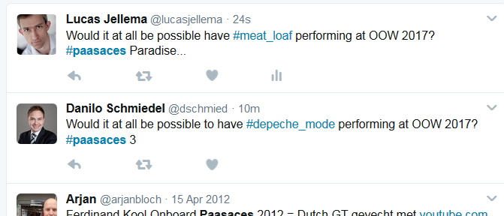
Now you tweet your Artist Proposal for OOW 2017
Use the hashtag #paasaces to get noticed by IoT CS
and add your favorite artist as the second hashtag
Note: use underscore for space

Slide 33
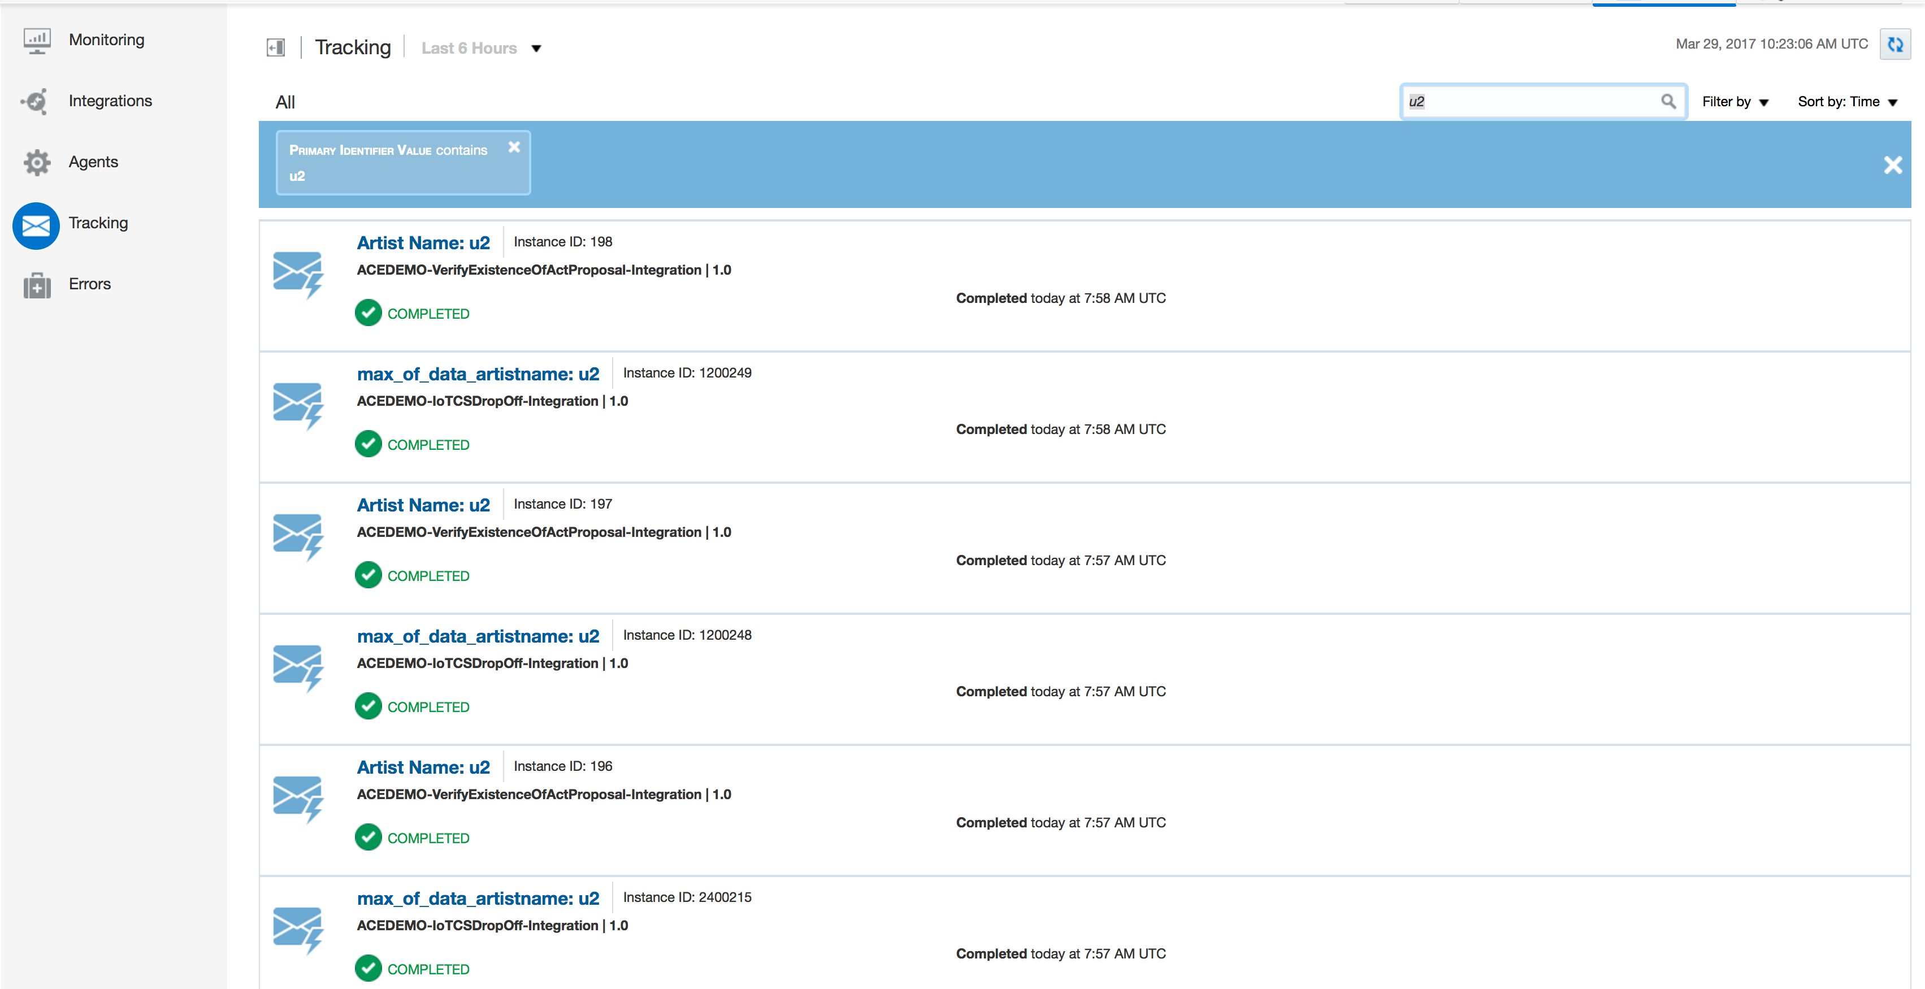
ICS

Slide 34
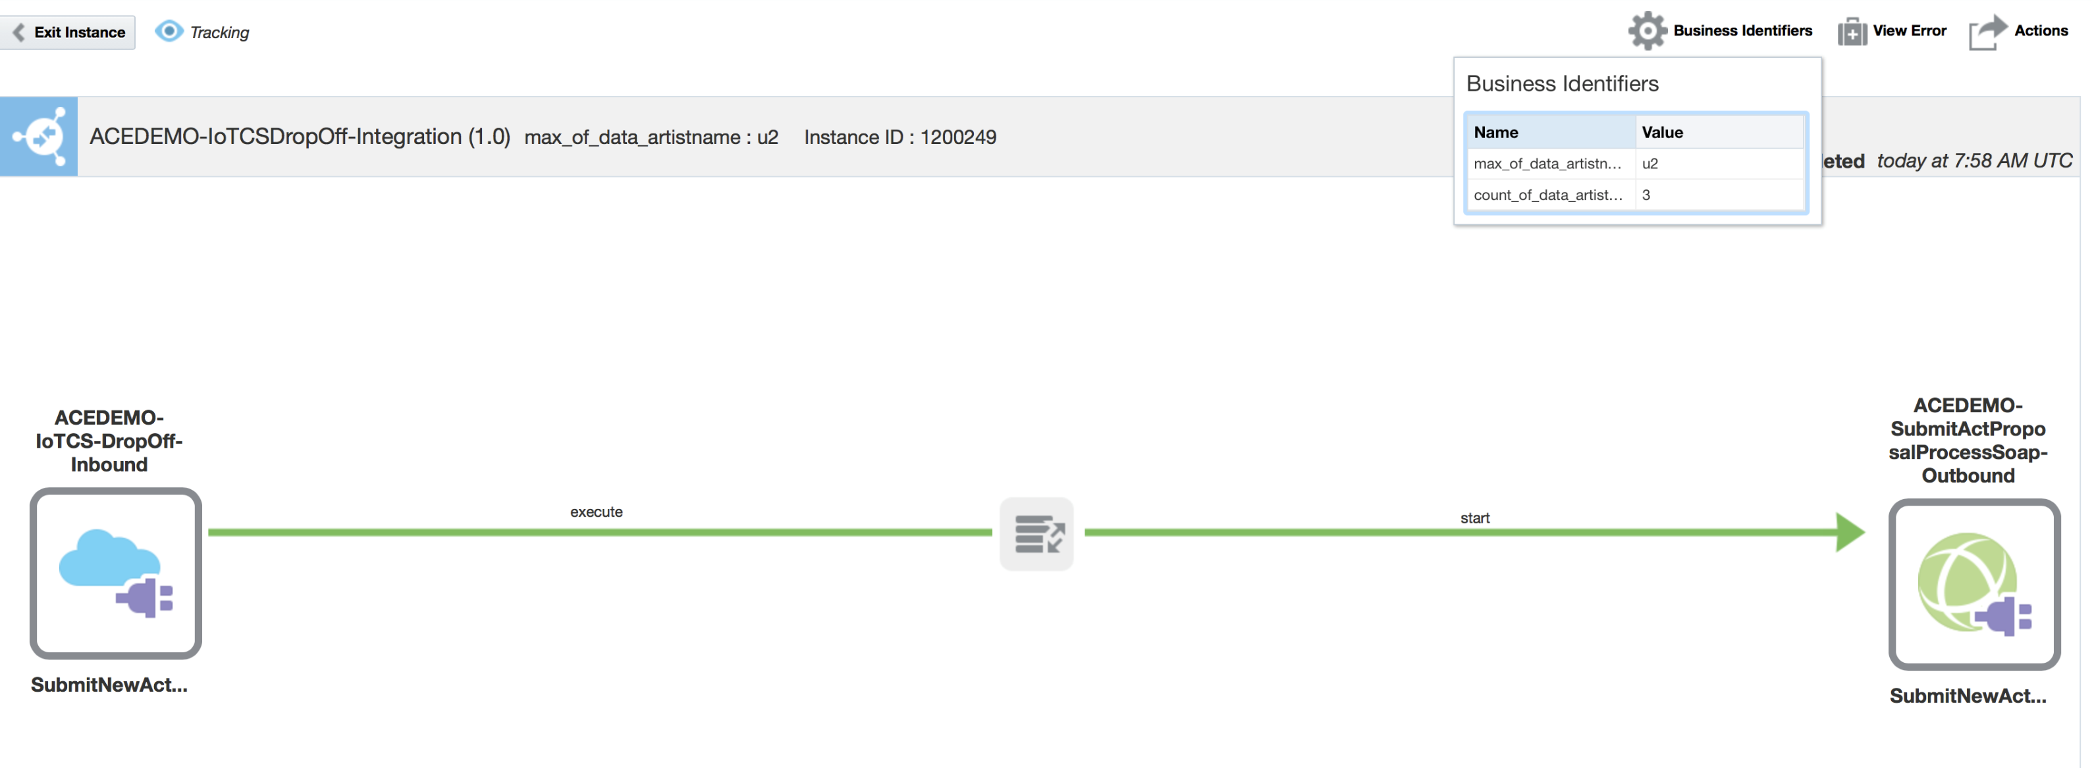
ICS

Slide 35
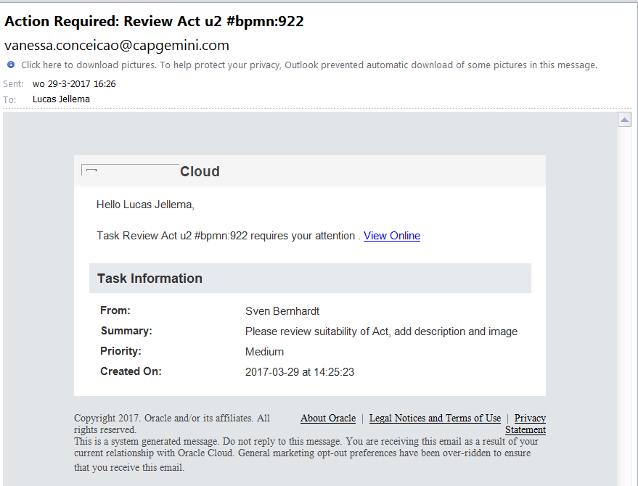
Email notification of new task in PCS instance

Slide 36
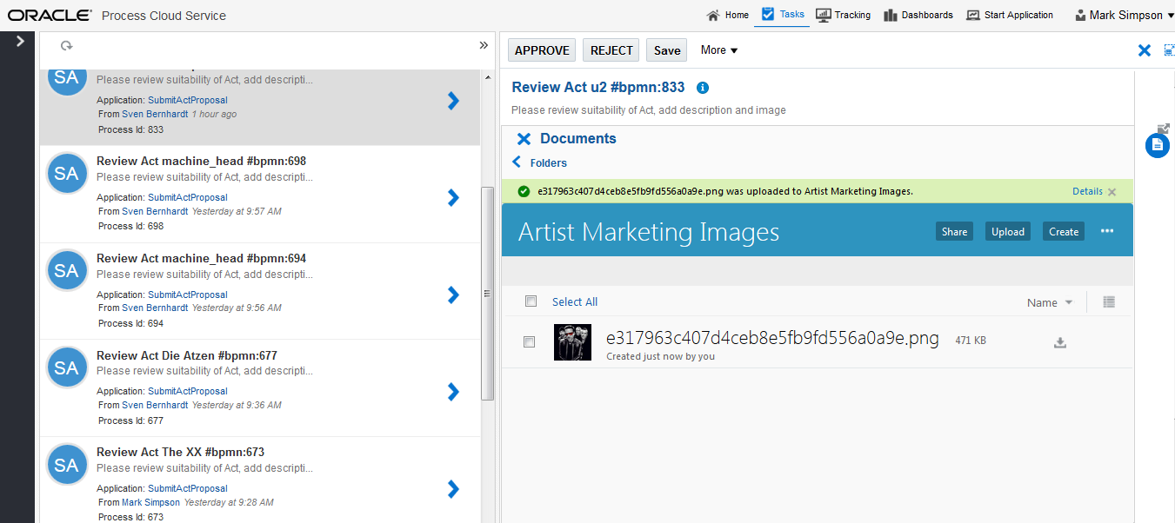
PCS

Slide 37
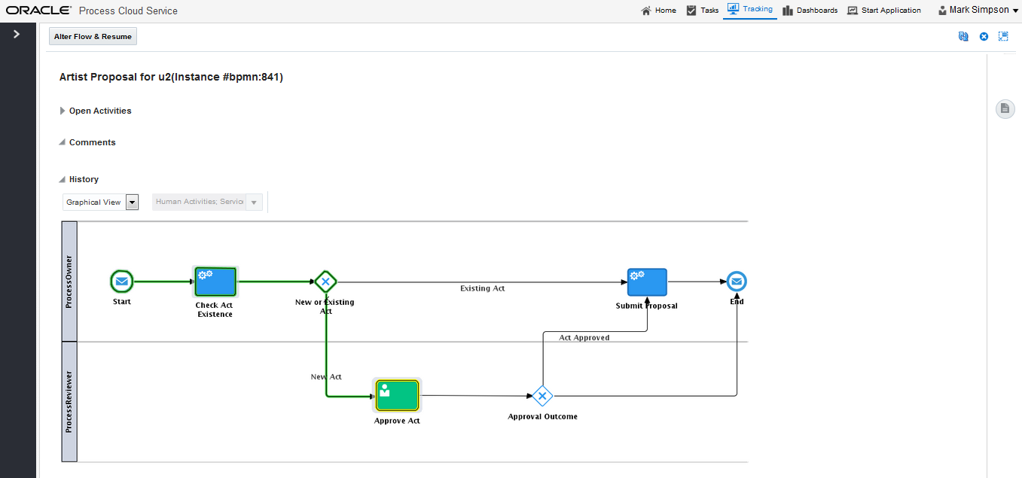
PCS

Slide 38
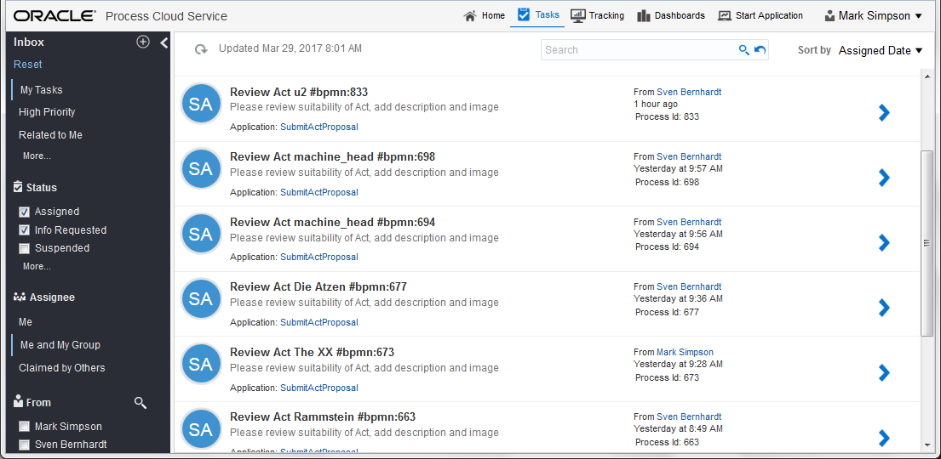
PCS

Slide 39
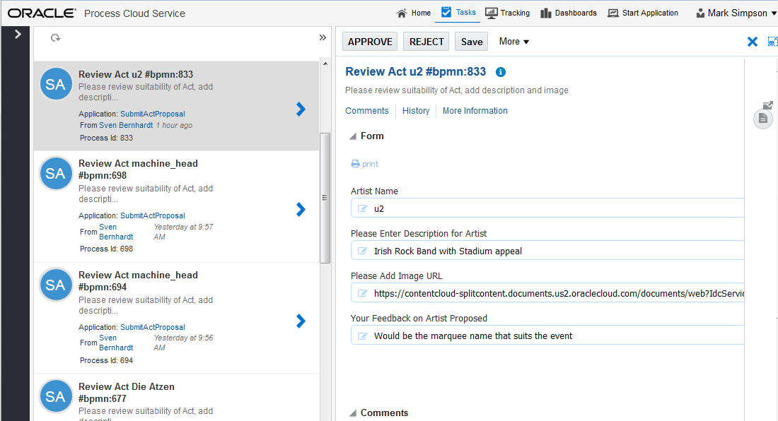
PCS

Slide 40
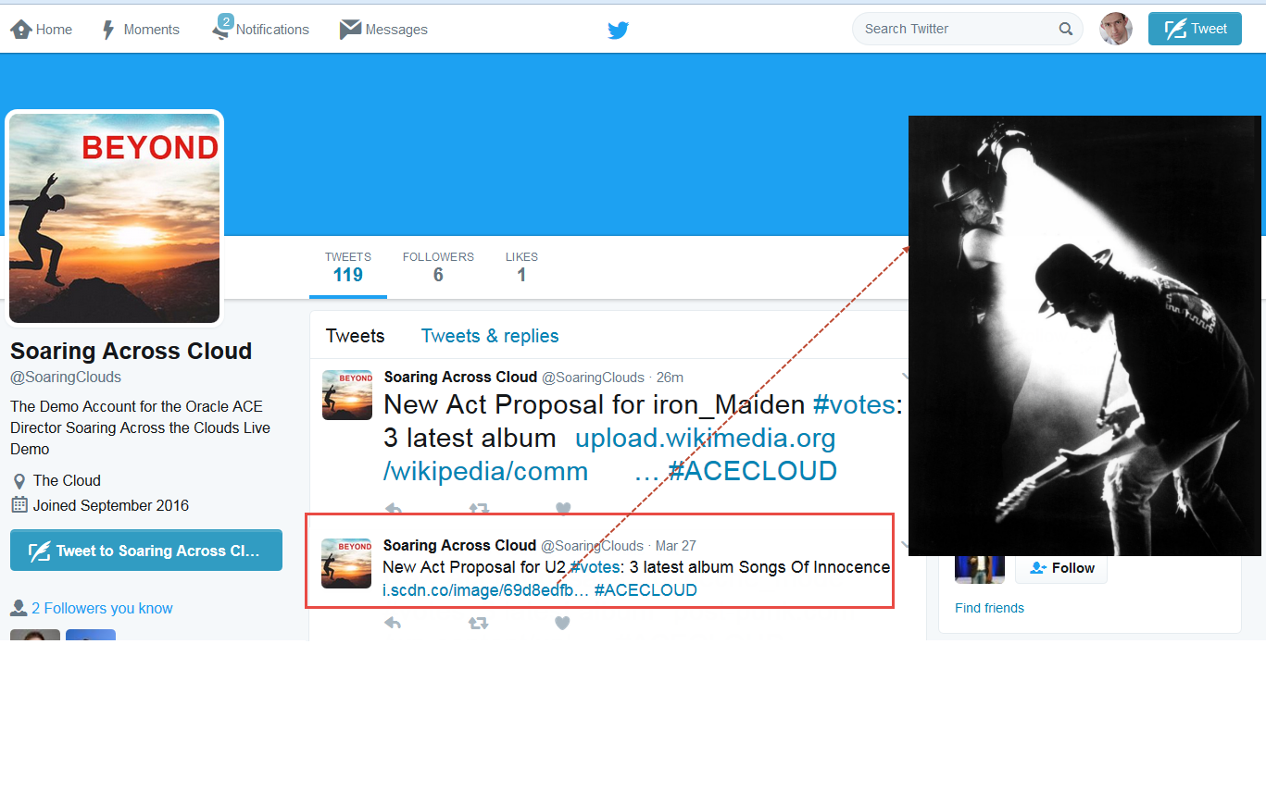
Outbound Twitter

Slide 41
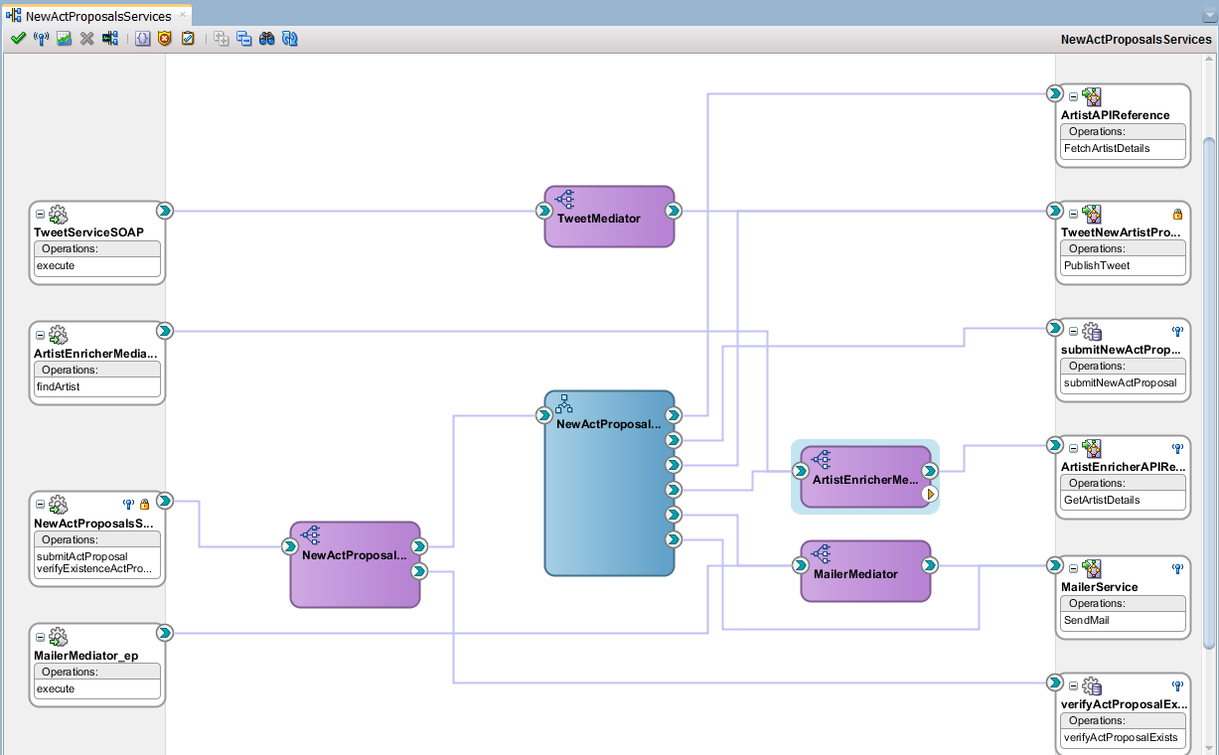
SOA CS

Slide 42
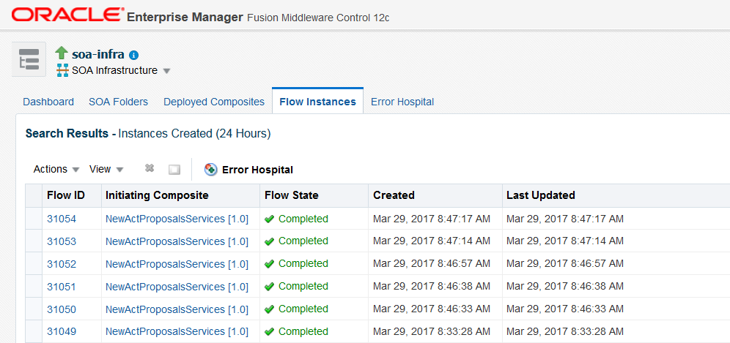
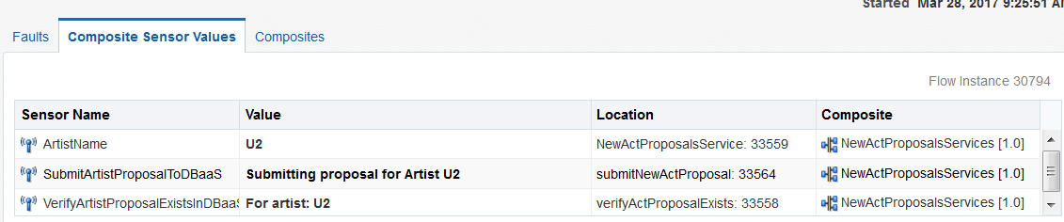
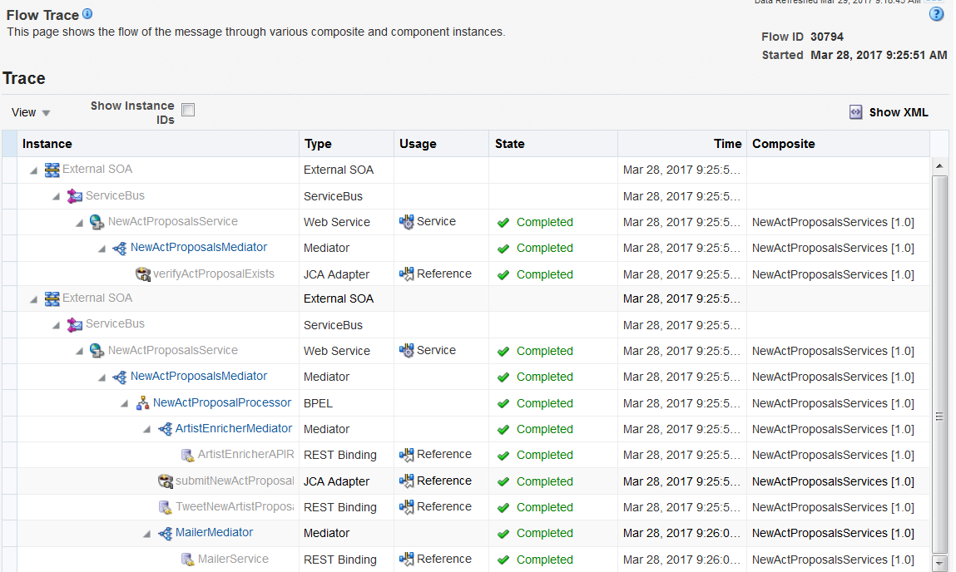

Slide 43
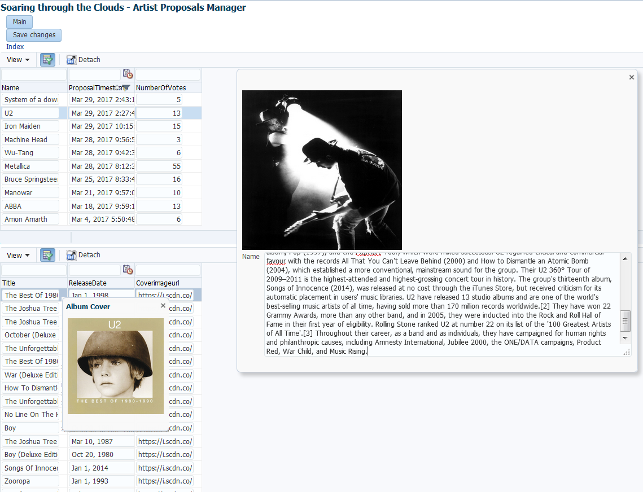
ADF on JCS

Slide 44
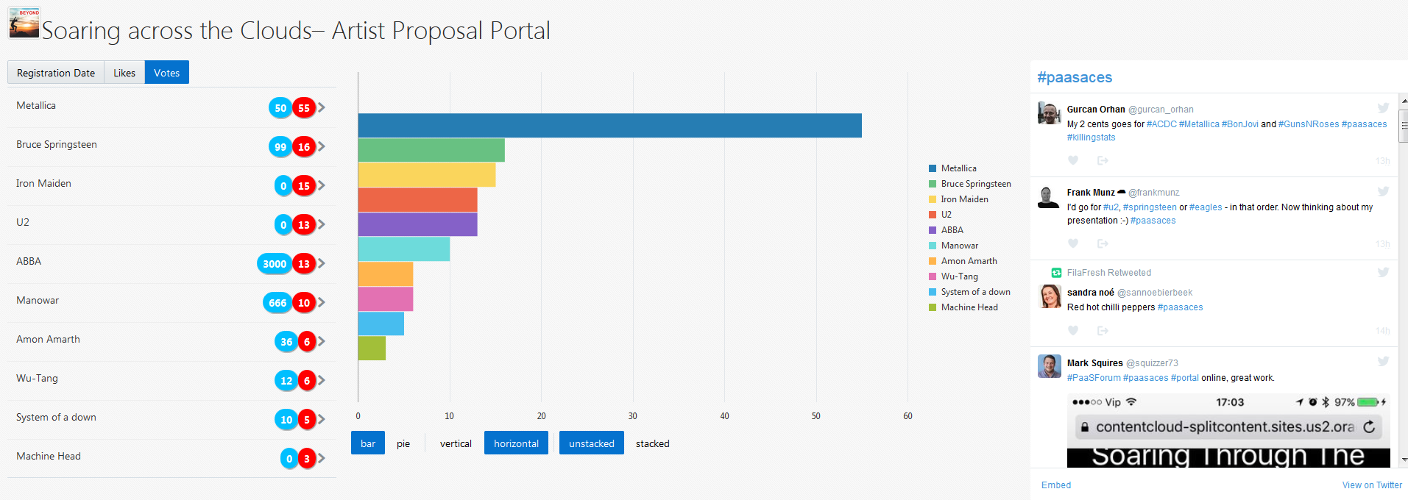
JET on ACCS

Slide 45
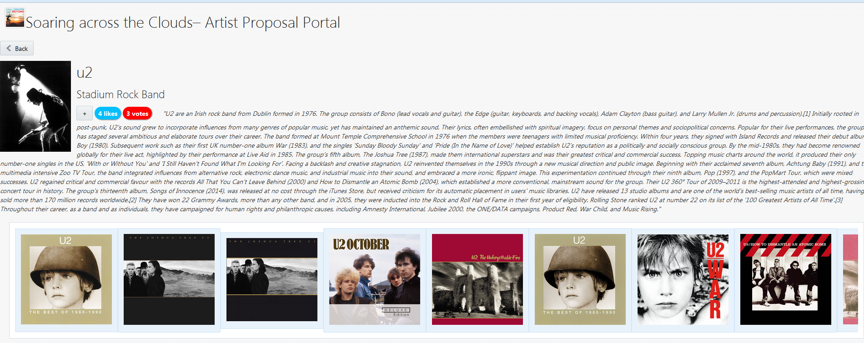
JET on ACCS

Slide 46
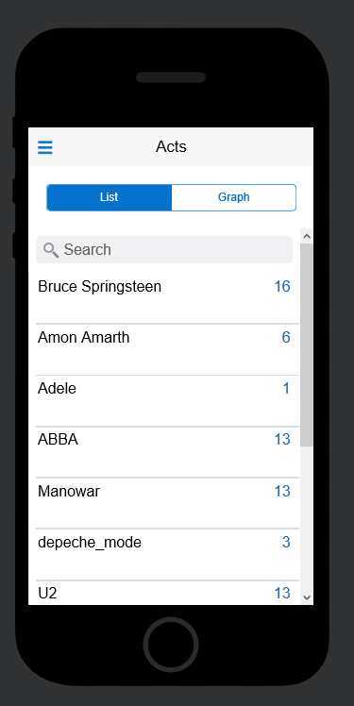
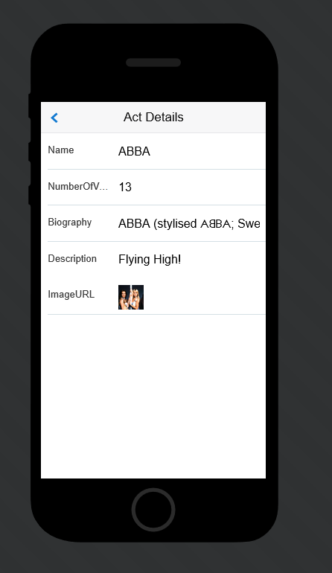
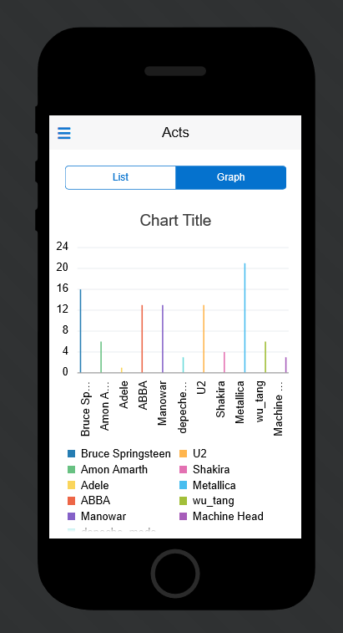
MAX

Slide 47

Content & Experience Cloud

Slide 48

Content & Experience Cloud

Slide 49

Content & Experience Cloud

Slide 50


Content & Experience Cloud

Slide 51

Artist Approval Confirmation
OSSI

Slide 52

Self-Service Recipes For Triggering Post-Actions
OSSI

Slide 53

Self-Service Job History
OSSI

Slide 54


Slide 55


Slide 56


Google Sheet for Analyzing the Results
OSSI

Slide 57

Asana Task for the Final Decision
OSSI

Slide 58

Calendar Invite With the Concert
OSSI

Slide 59

Google Calendar details

Slide 60

OMC - APM

Slide 61

OMC - APM

Slide 62

OMC APM

Slide 63

OMC APM

Slide 64



Slide 65

OMC – Dissecting an instance

Slide 66

Log Analytics

Slide 67


Slide 68


Slide 69


Slide 70
Conclusion
What about that world record?

Slide 71
Cloud services architecture++
Real “Things” (Pis, Arduino’s, …)
SOA CS Business Insight
Data Vizualization
Application Cache
Audience
(O)SSI
IoT CS
ACCS
DBaaS
LA
LA
ICS
Container Cloud
Event Hub
Elastic Search
SOA CS
OMC
(APM, LA)
Sites CS
PCS
APM
JCS
LA
Messaging Cloud Service
APM
Application Builder Cloud Service
LA
API P
MCS
Doc CS
Conversations
ChatBot
JET on
AppContainer CS
Dev CS
MAX
Compute
Storage
APM

Slide 72






Conclusion
What about that world record?
Mutual integration of Oracle PaaS Cloud services is becoming more natural
The current Oracle PaaS palette offers many options for implementing Platform components
There is some overlap
There is some lack of obvious integration
And there are more services to be added – so next year, a new record!
Provided we get a longer slot

